Slide 1
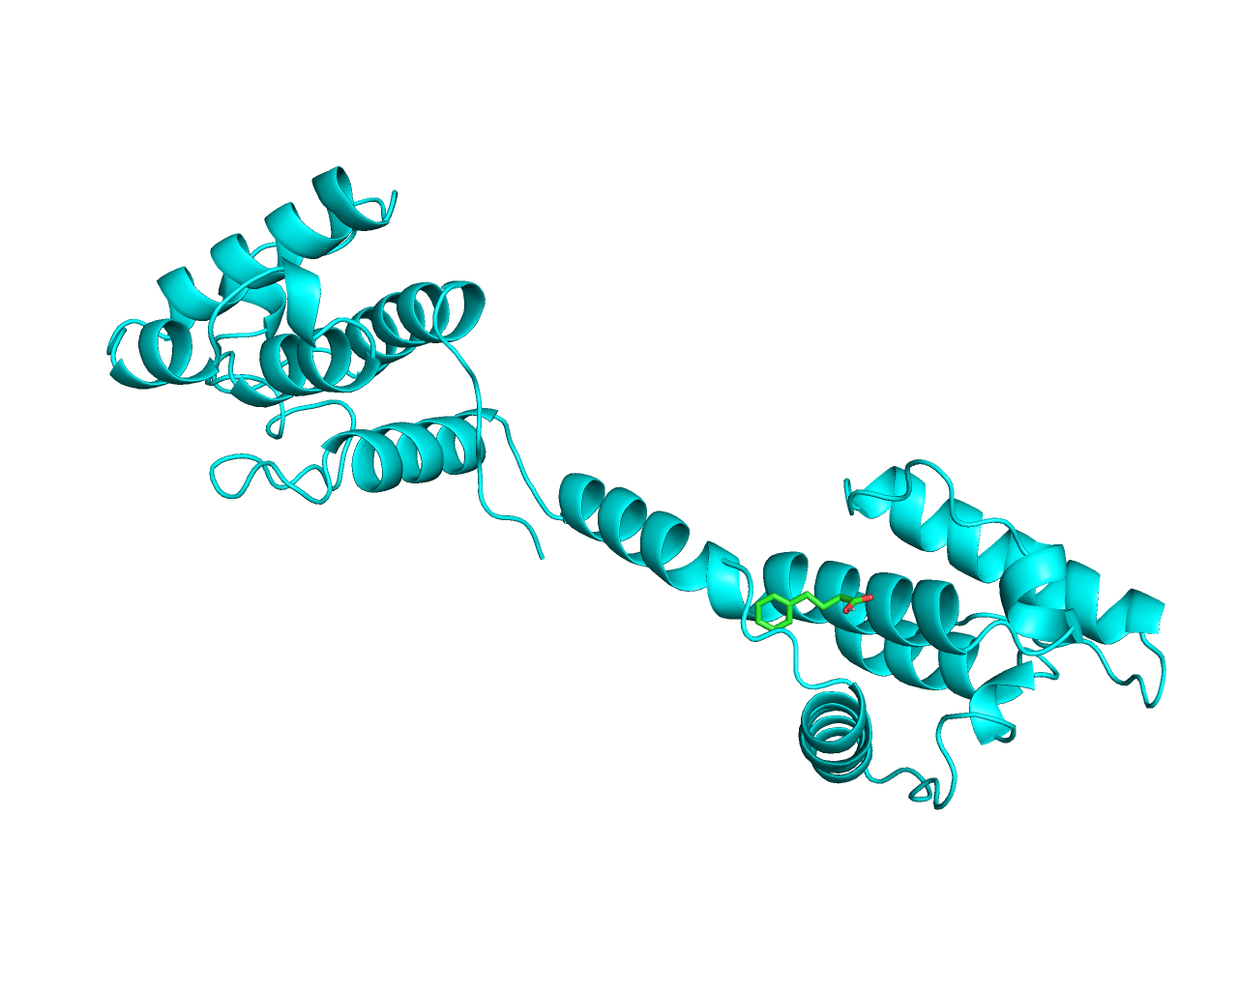
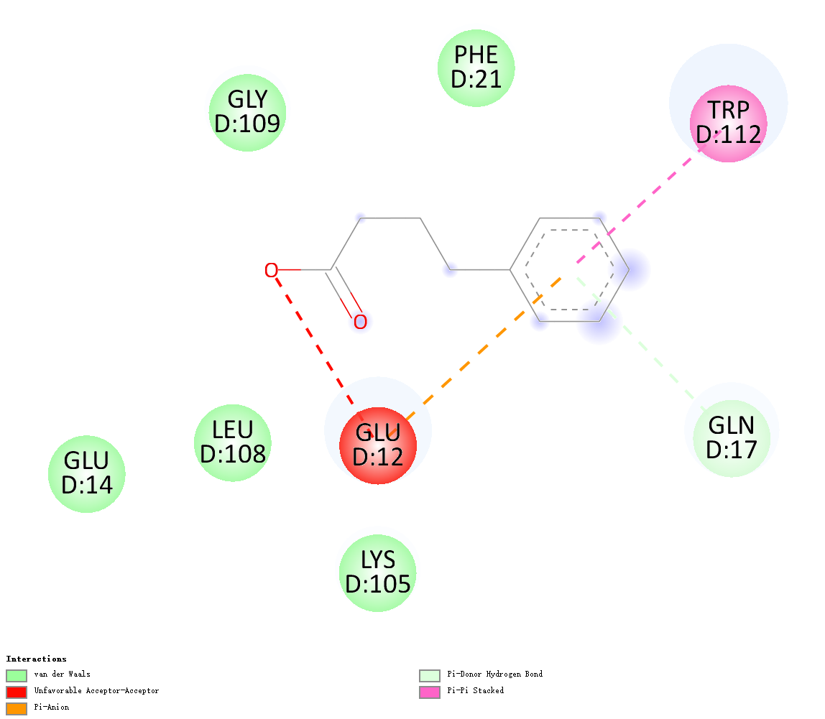
DMD-4-Phenylbutyric Acid

Slide 2
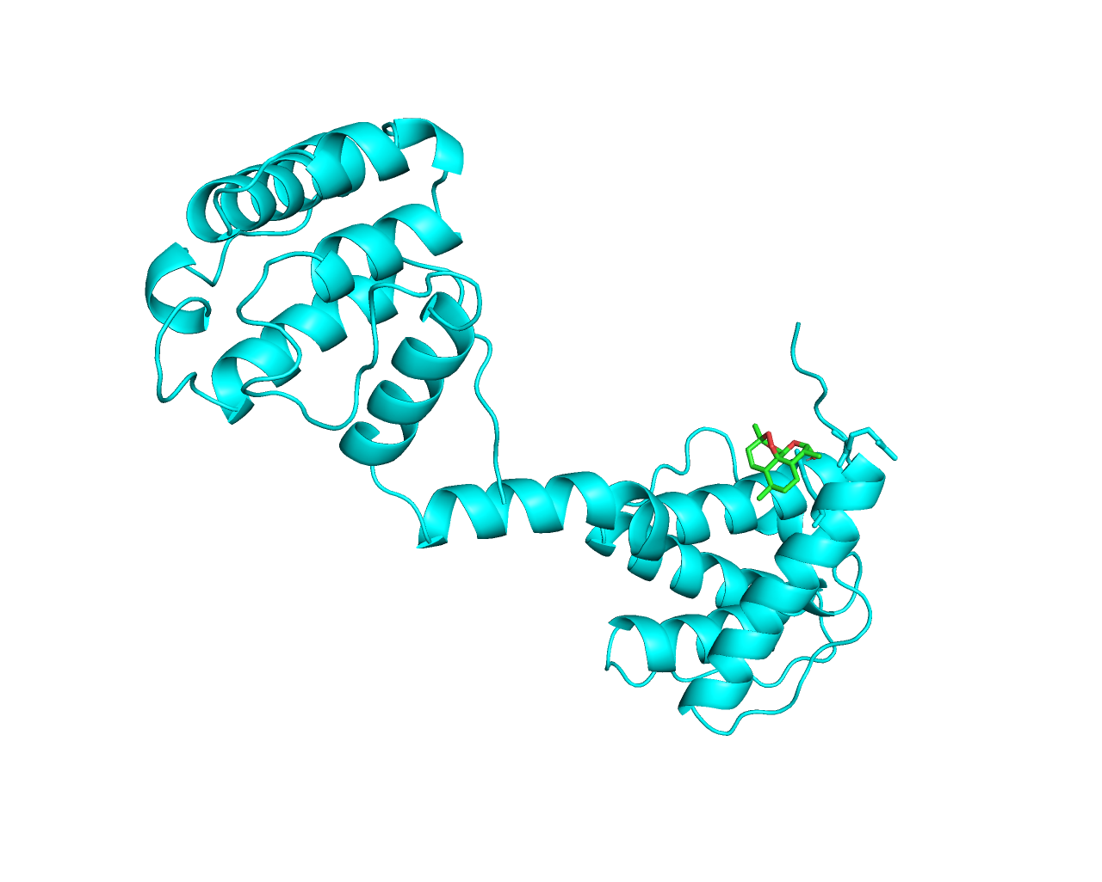
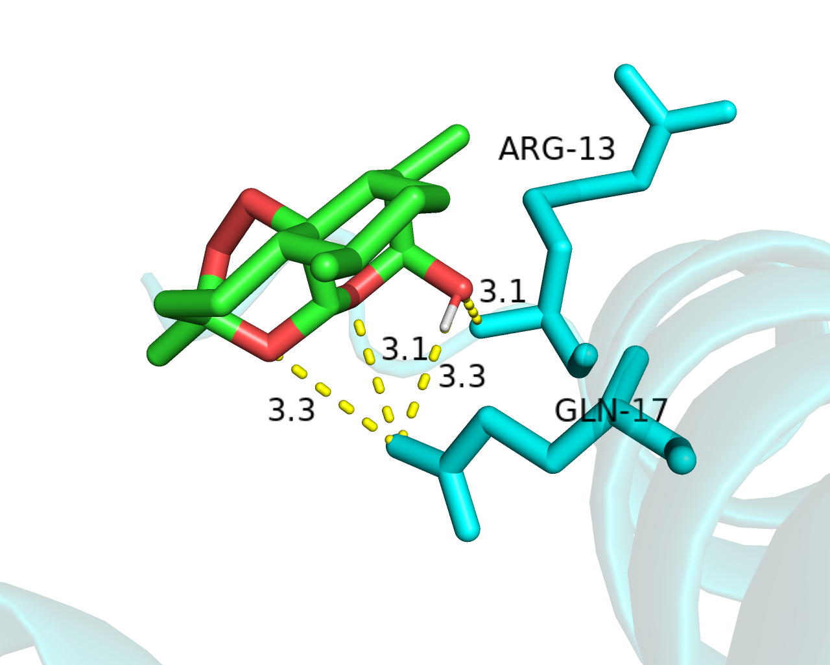
DMD-Artenimol

Slide 3
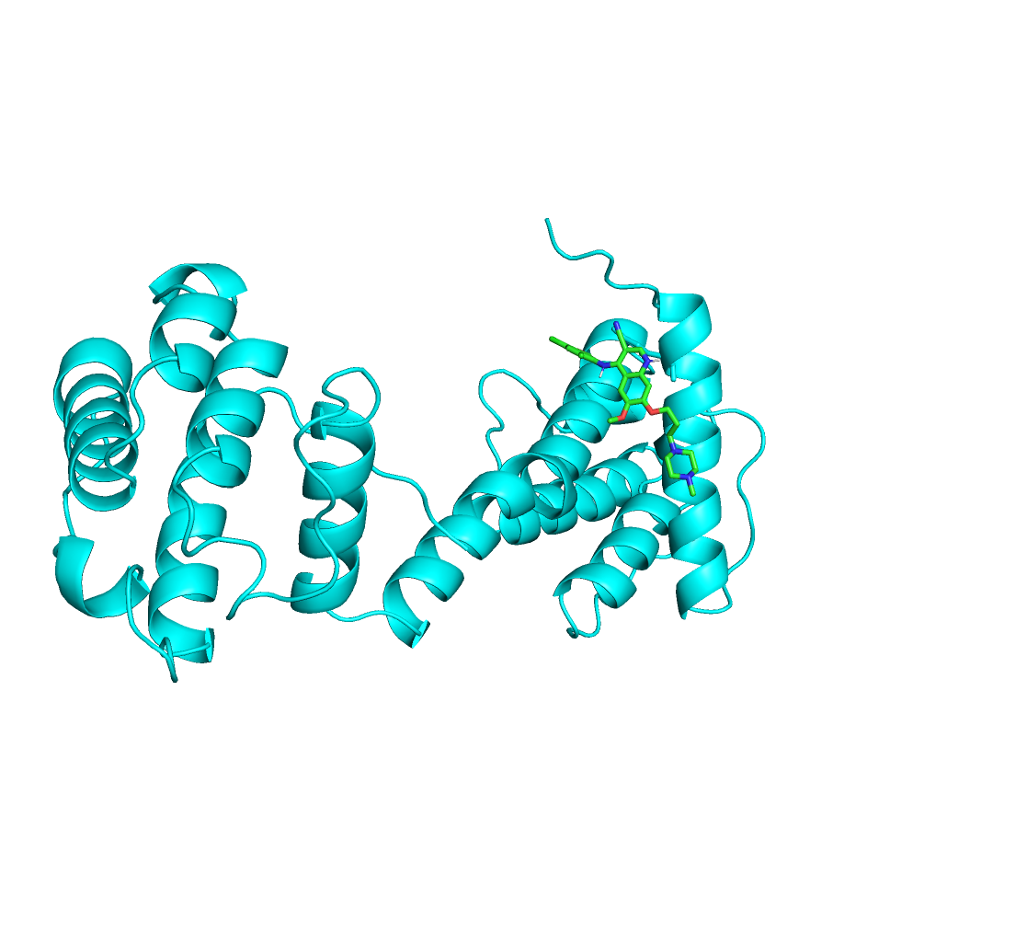
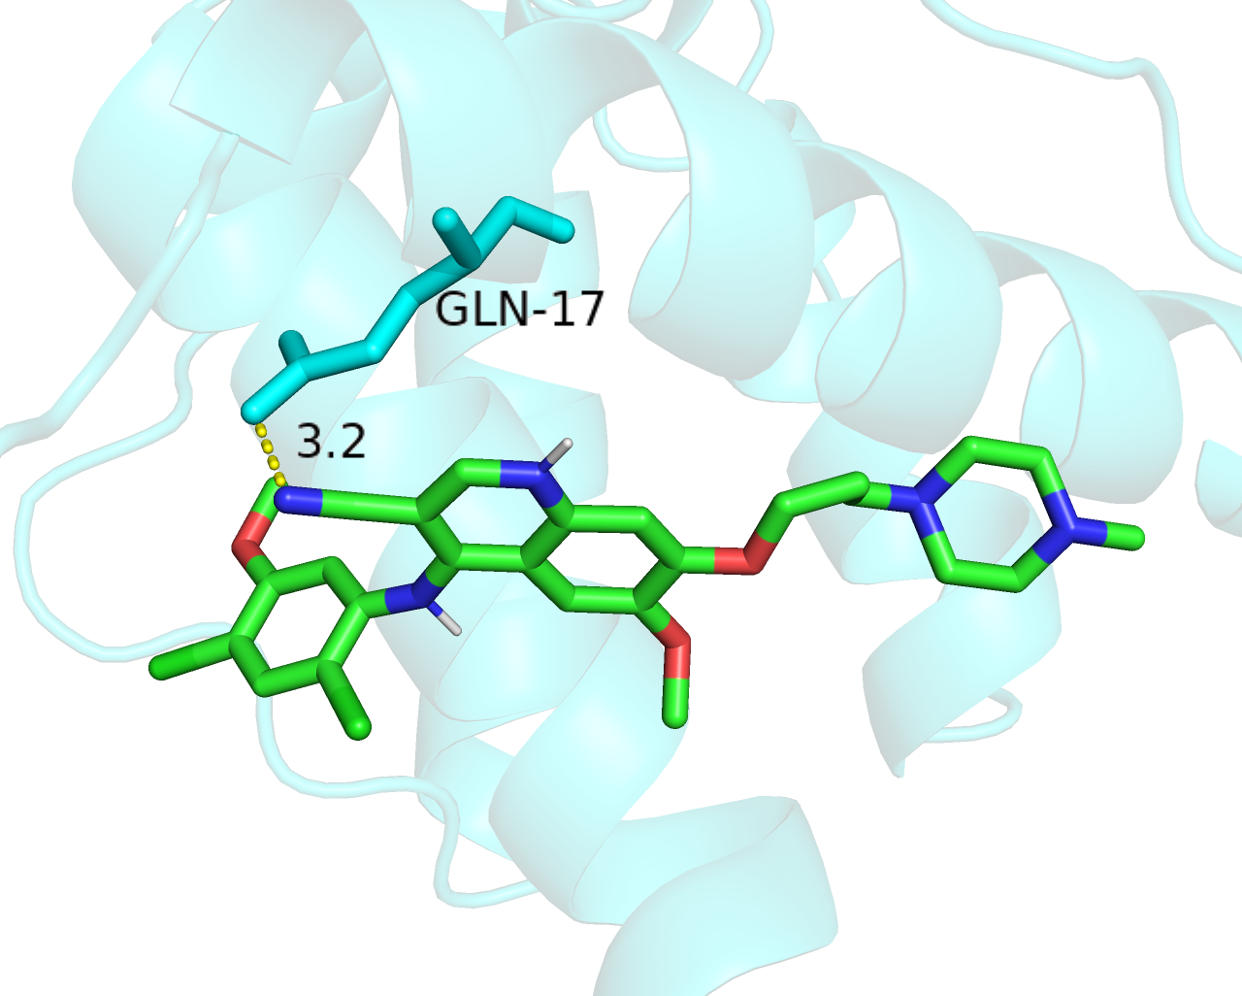
DMD-Bosutinib

Slide 4
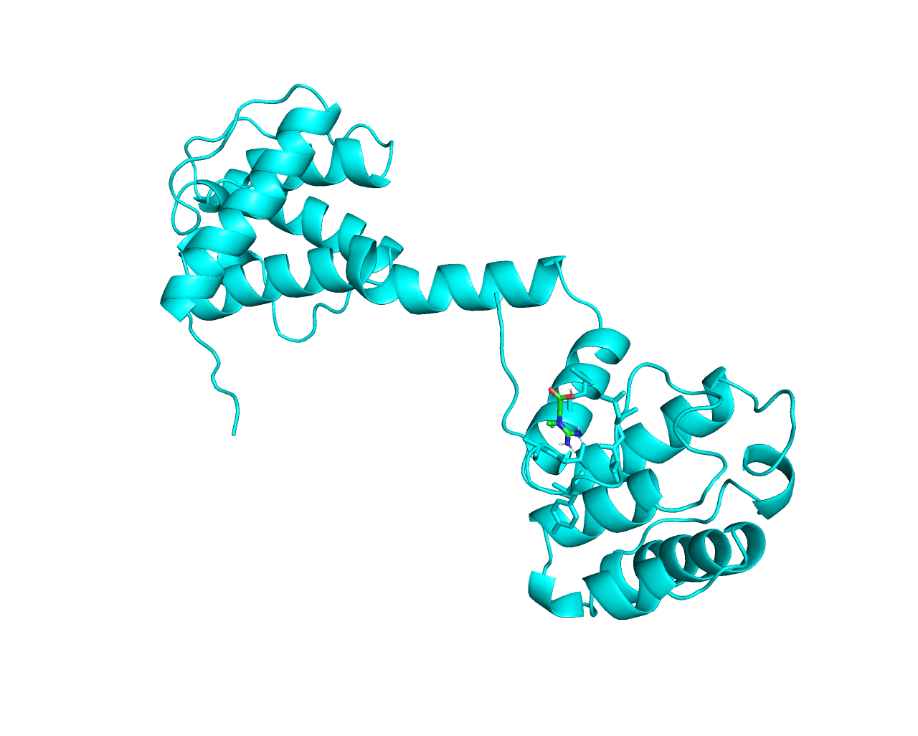
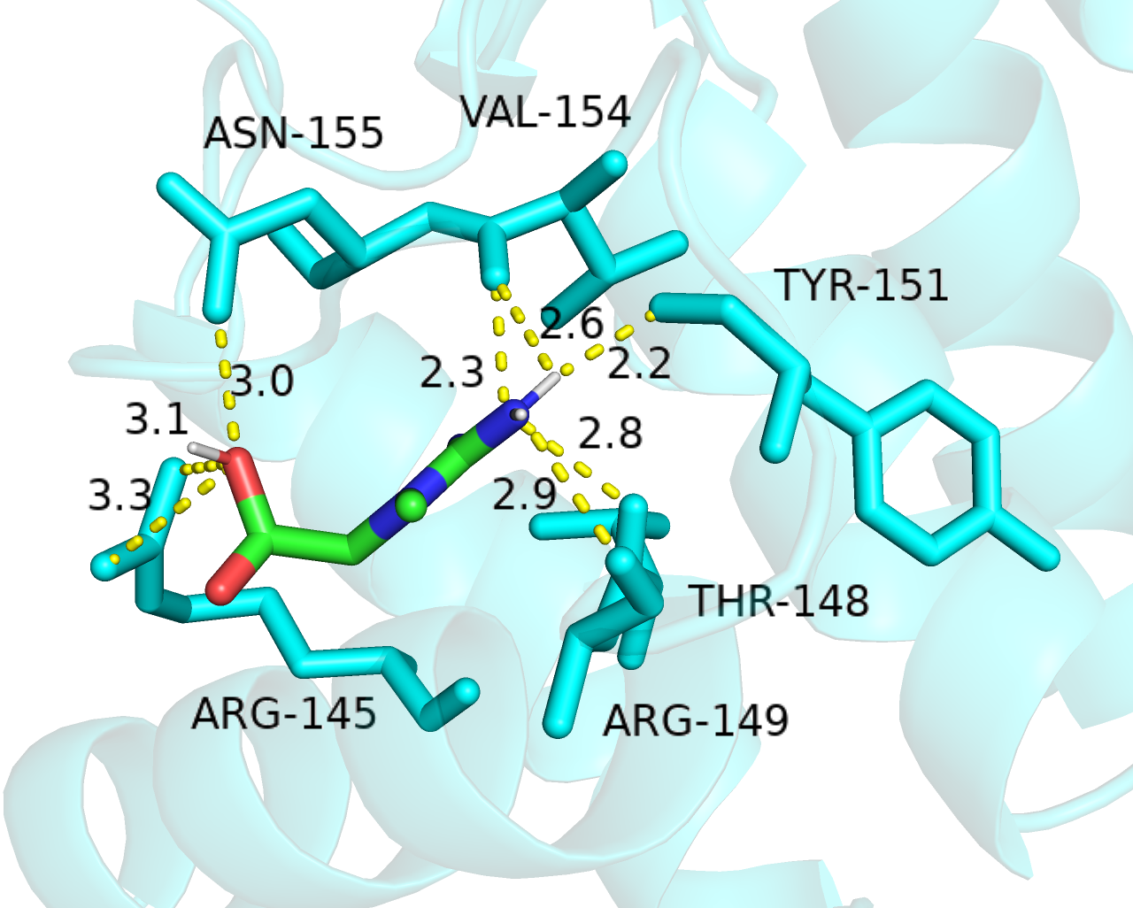
DMD-Creatine

Slide 5
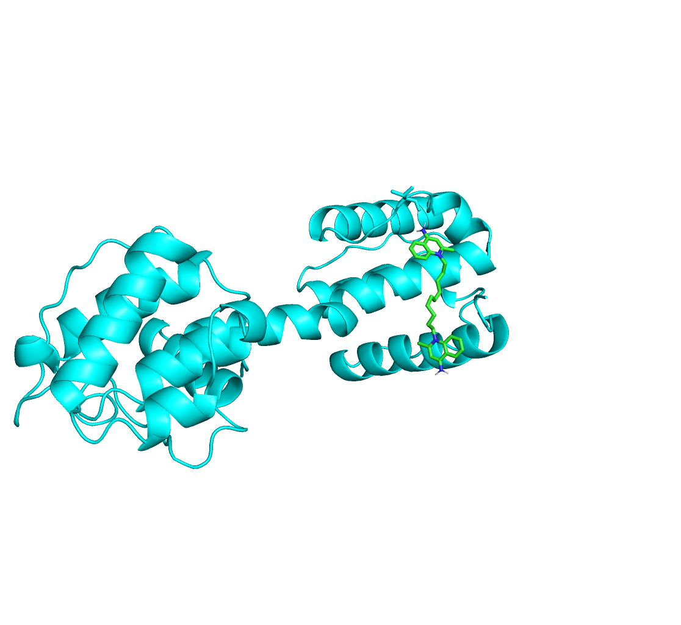
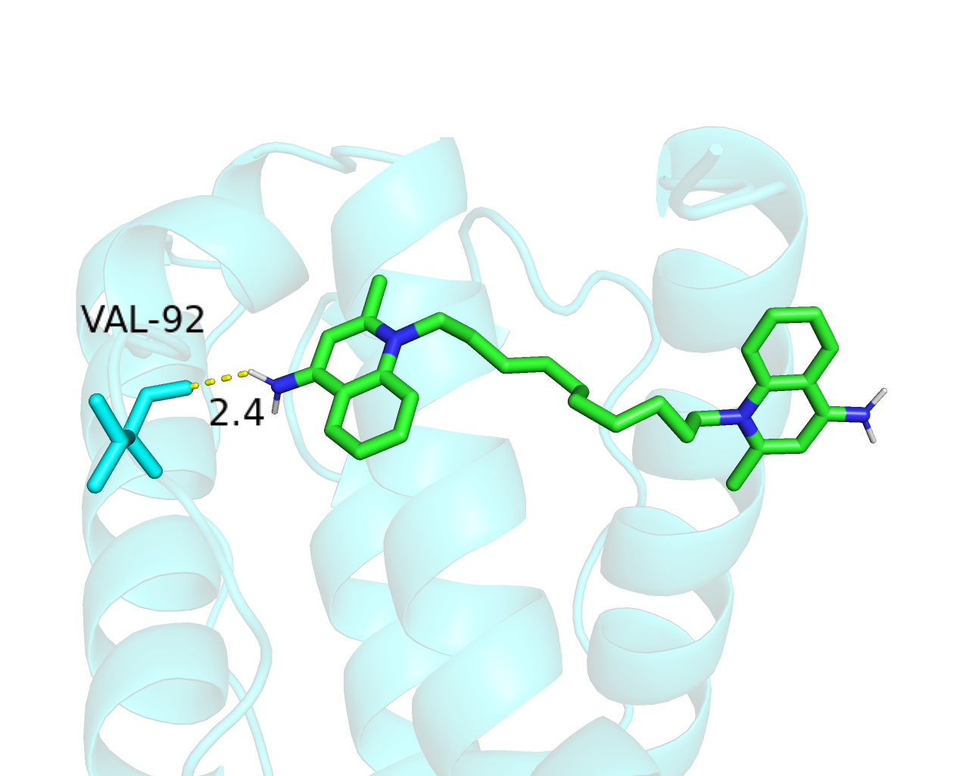
DMD-Dequalinium

Slide 6
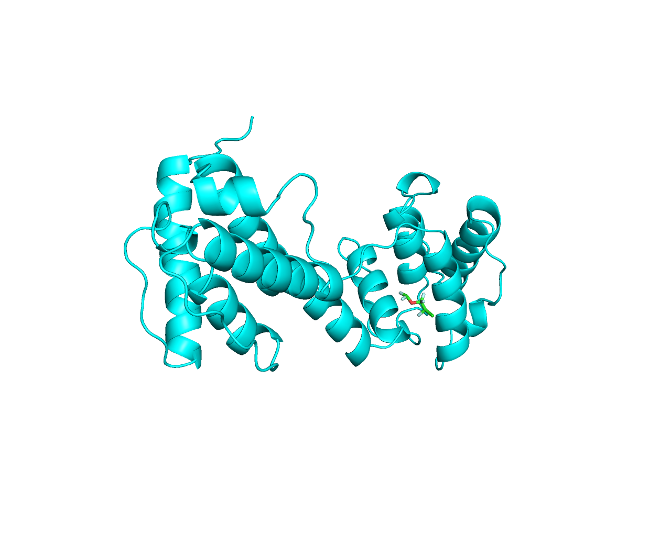
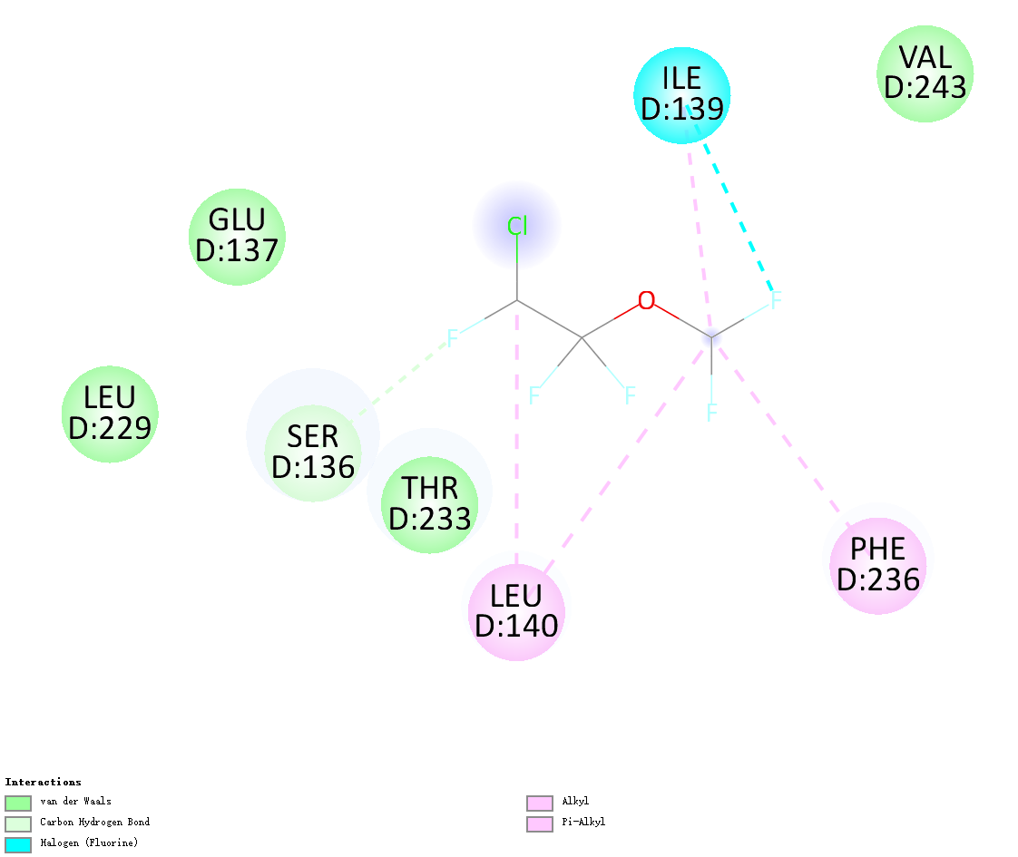
DMD-Enflurane

Slide 7
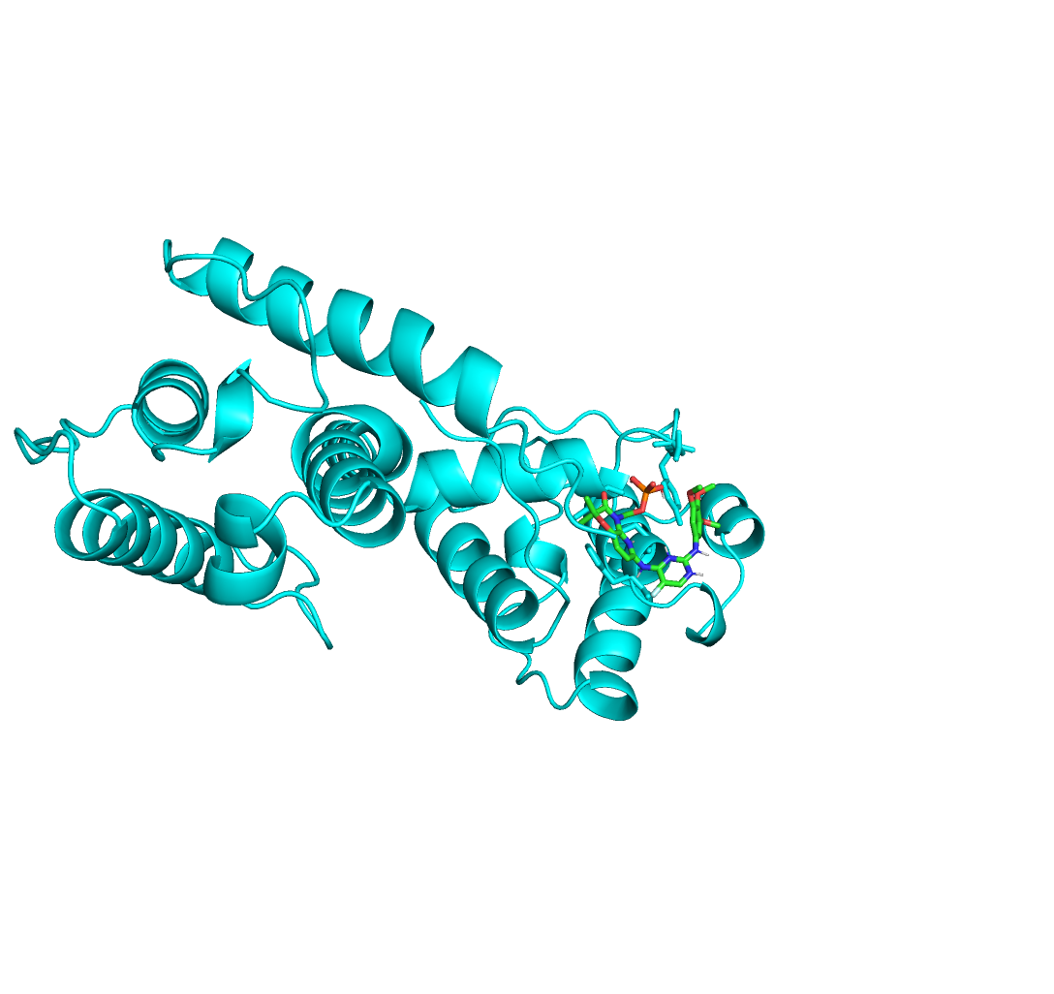
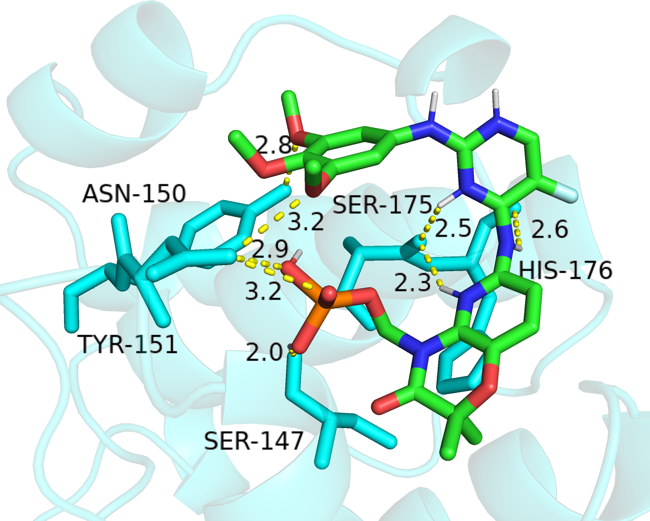
DMD-Fostamatinib

Slide 8
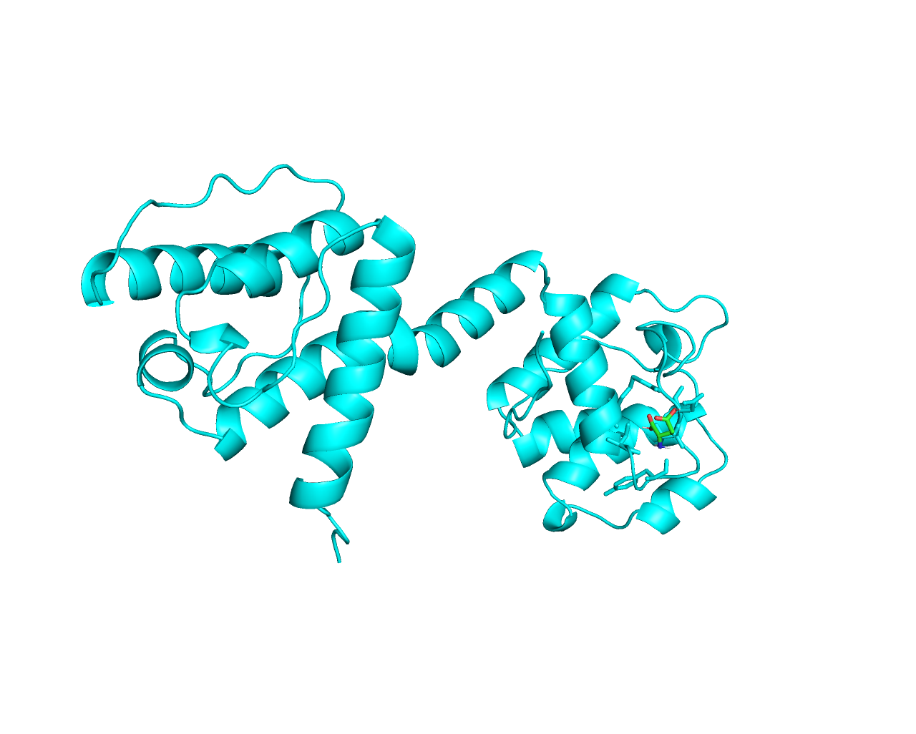
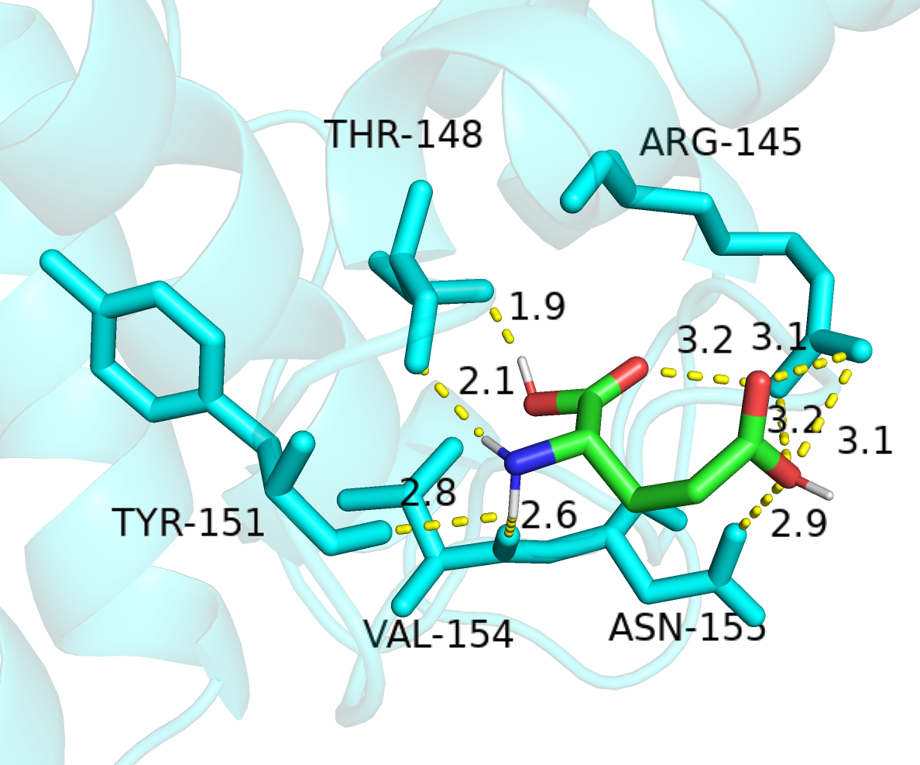
DMD-Glutamic acid

Slide 9
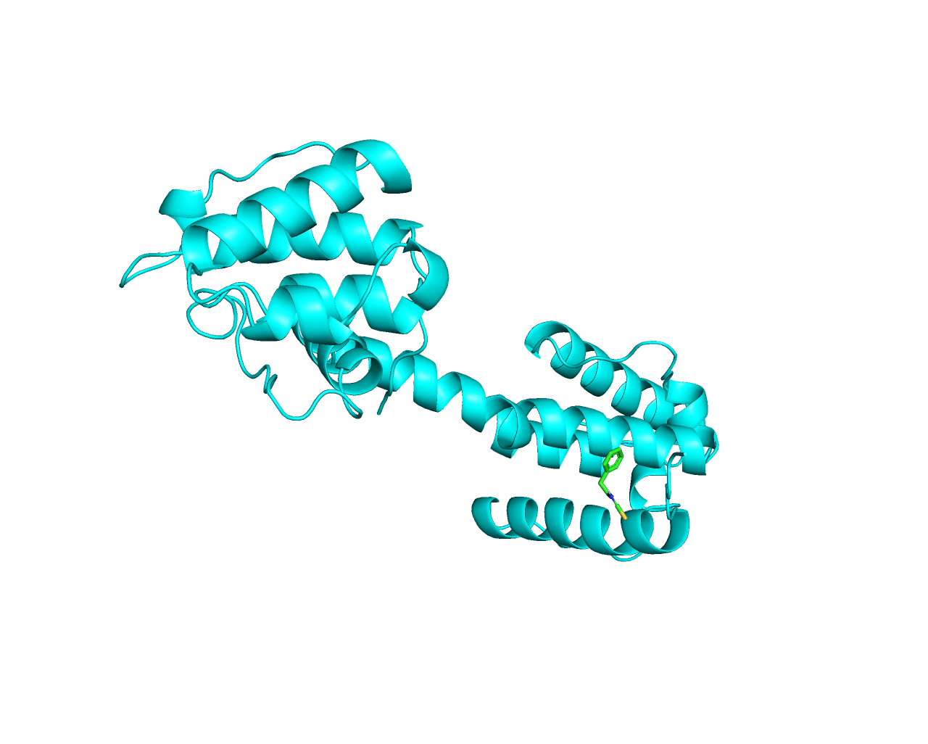
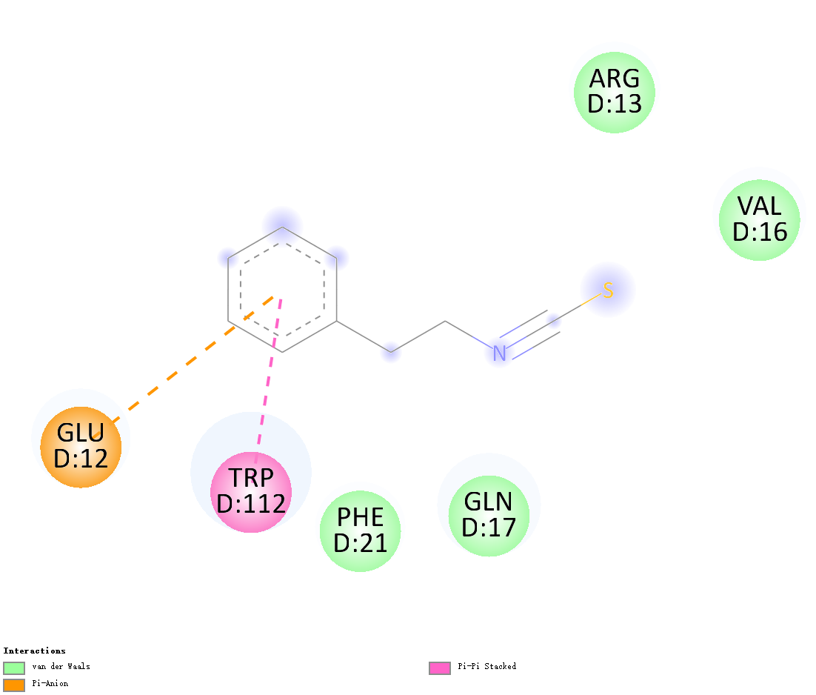
DMD-Phenethyl Isothiocyanate

Slide 10
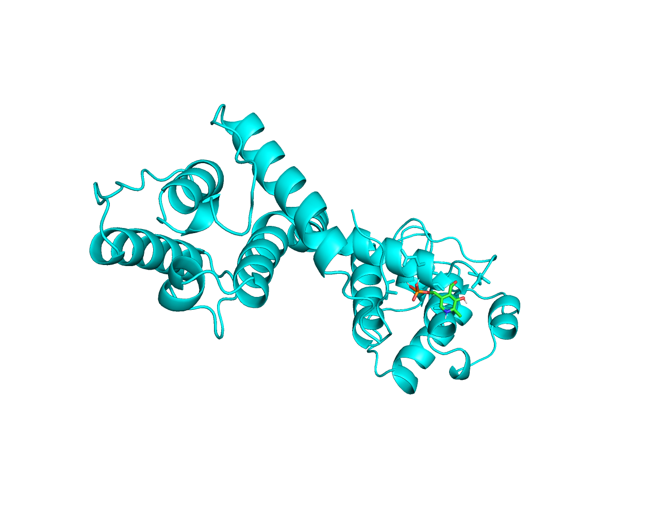
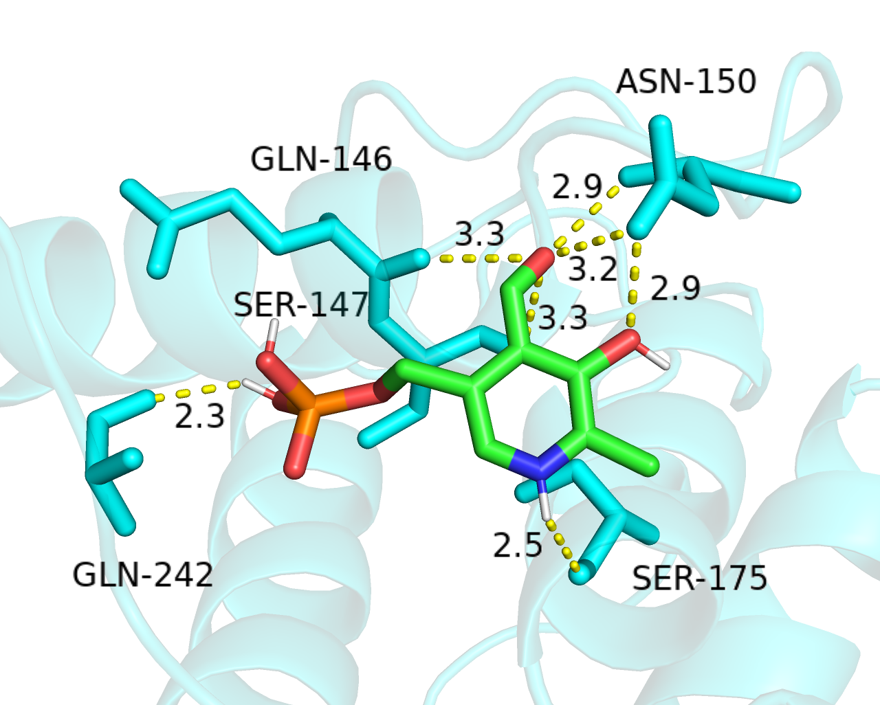
DMD-Pyridoxal phosphate

Slide 11
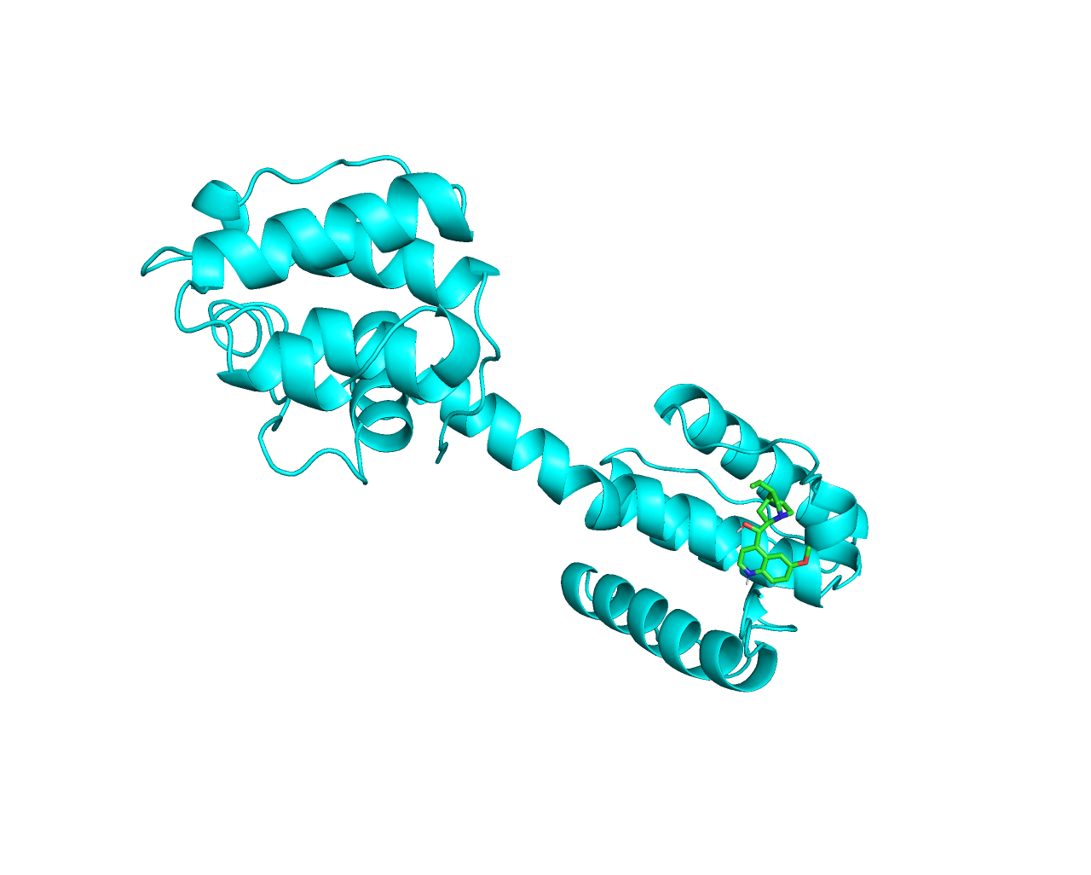
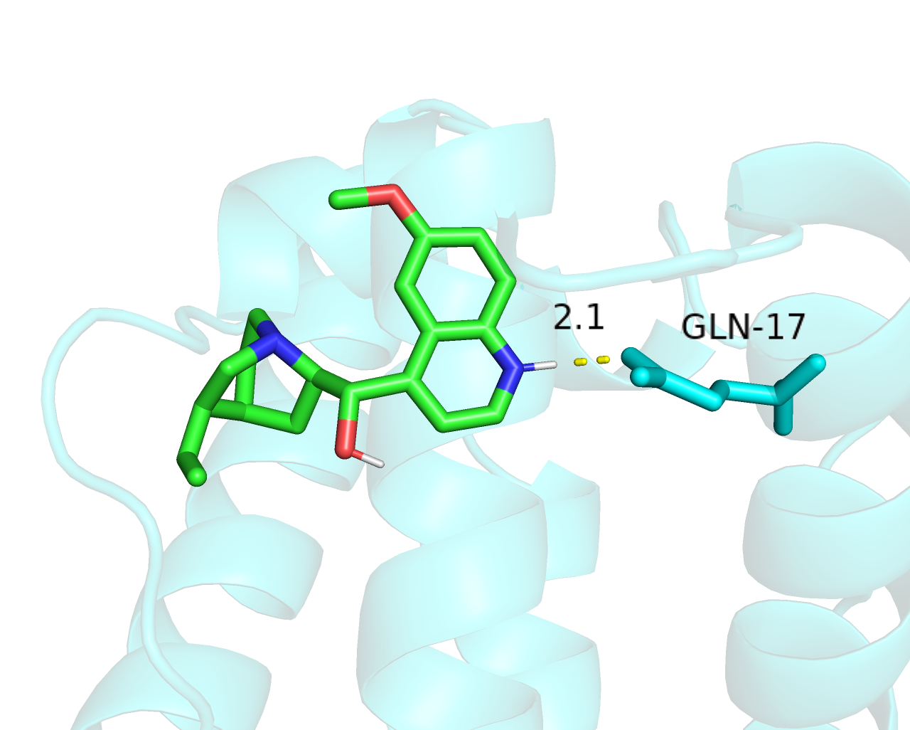
DMD-Quinidine

Slide 12
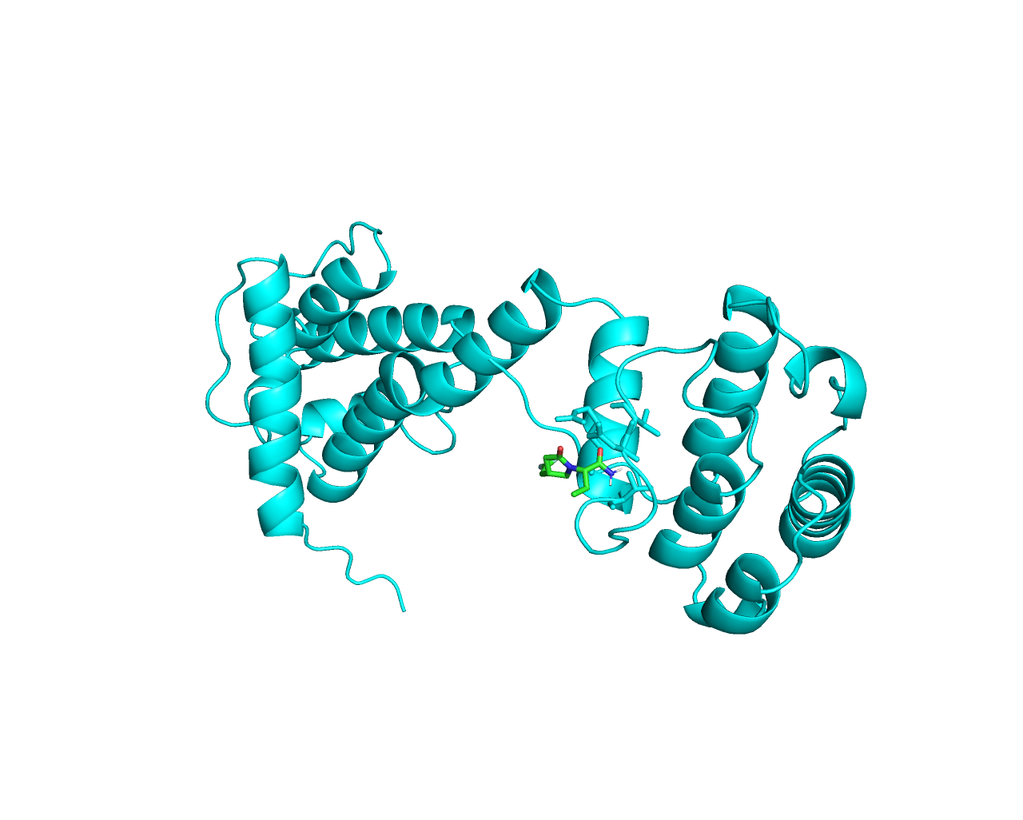
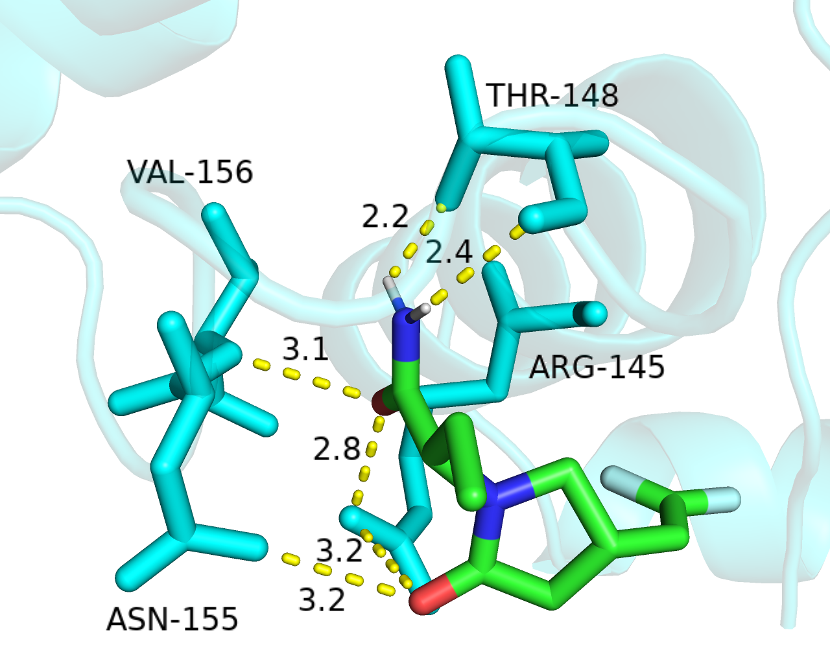
DMD-Seletracetam

Slide 13
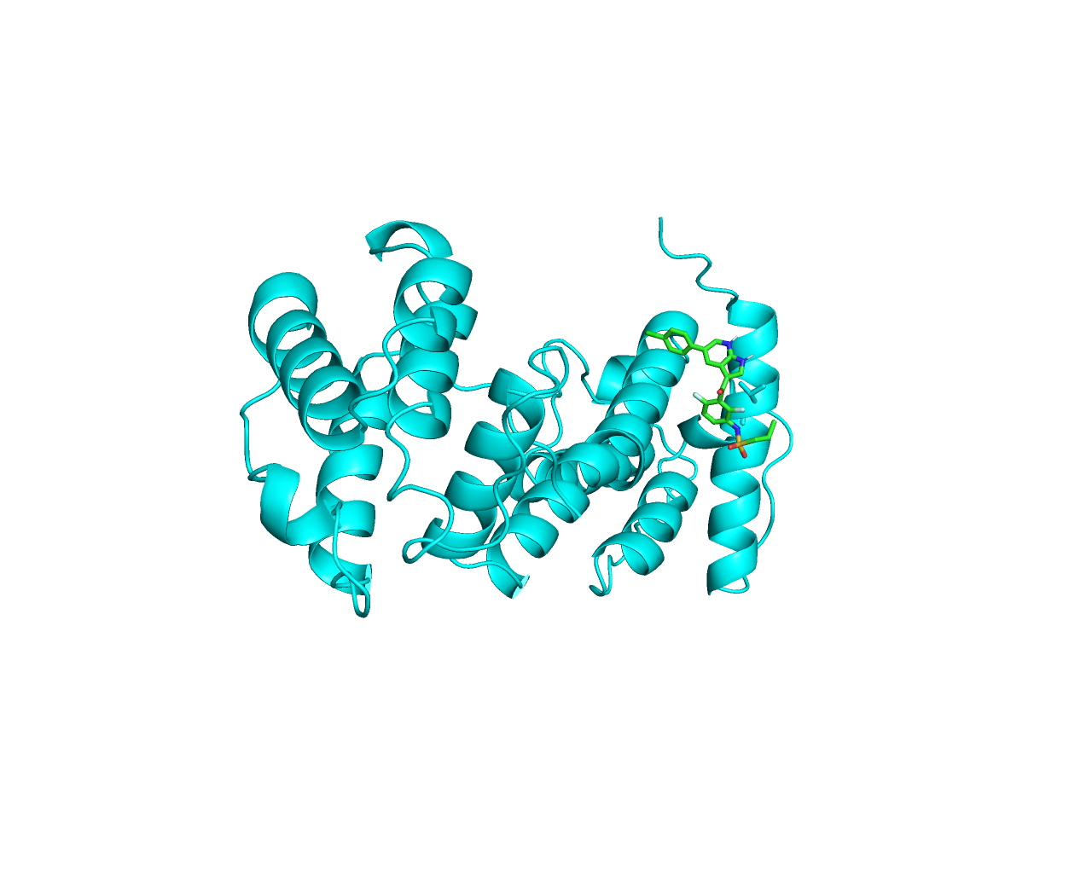
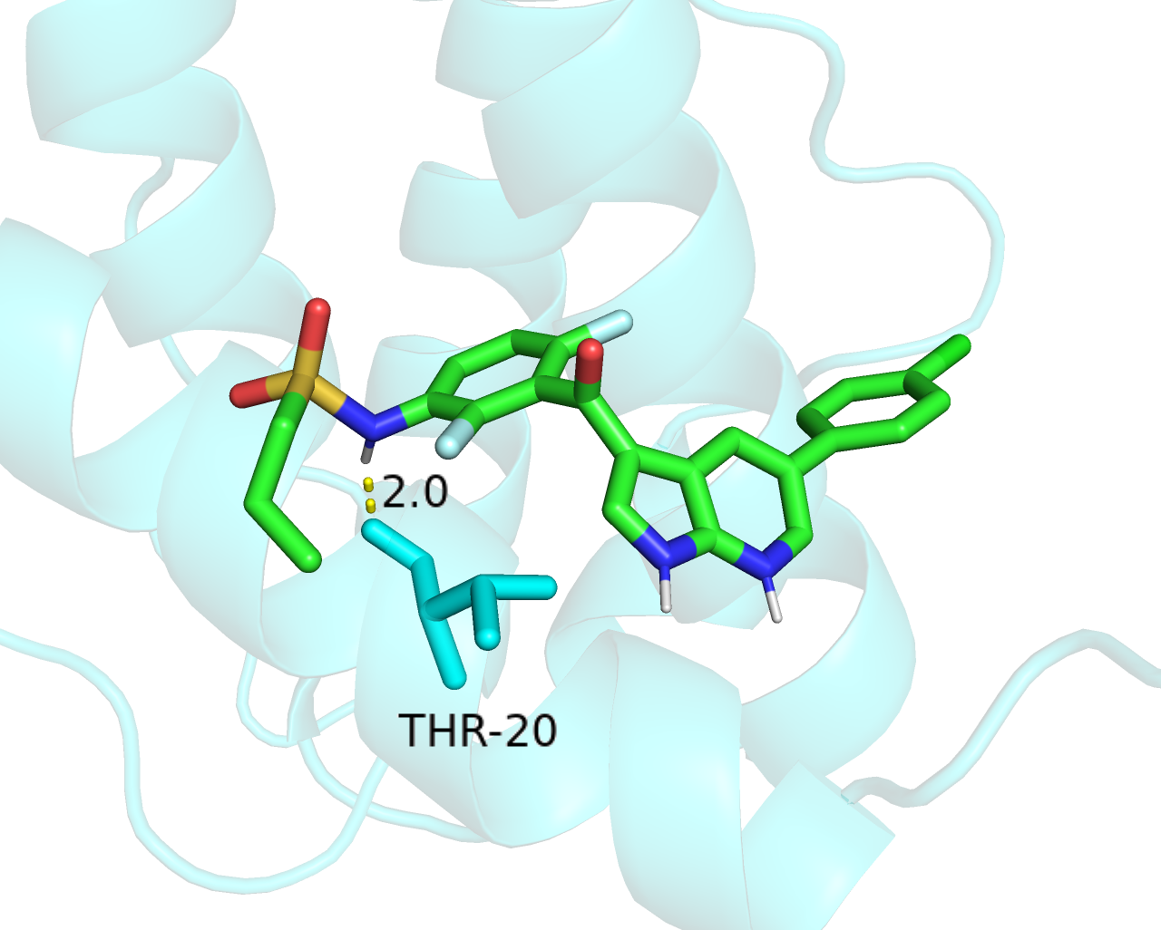
DMD-Vemurafenib

Slide 14
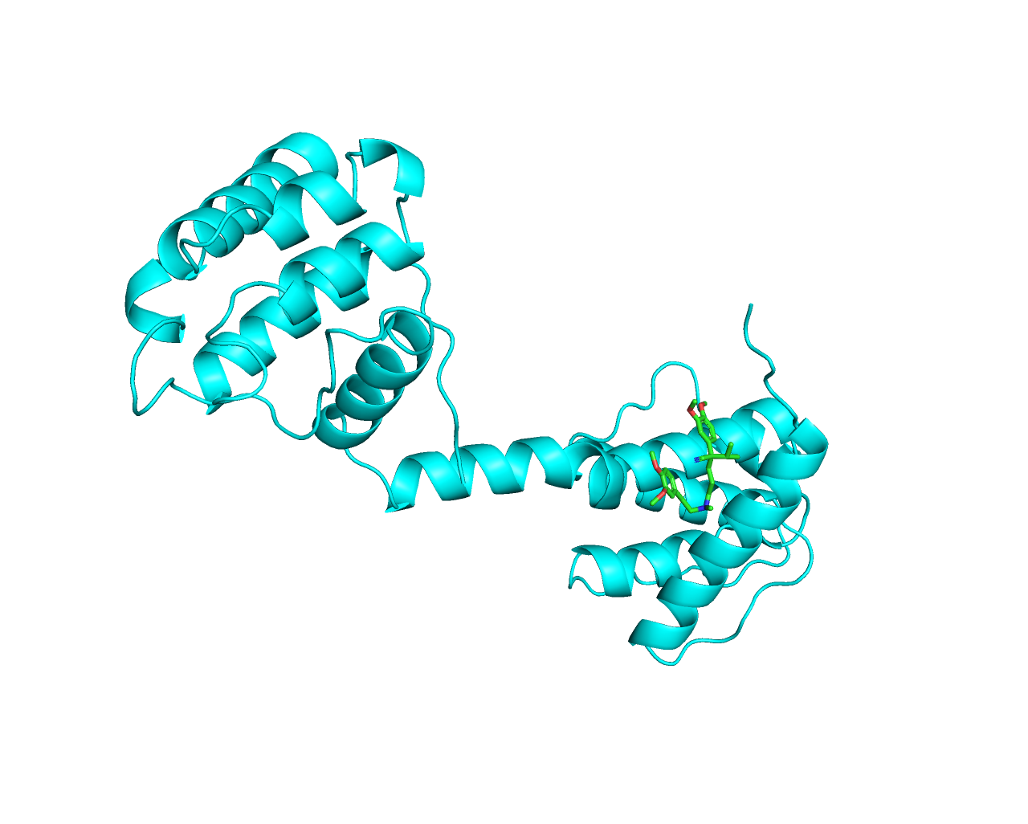
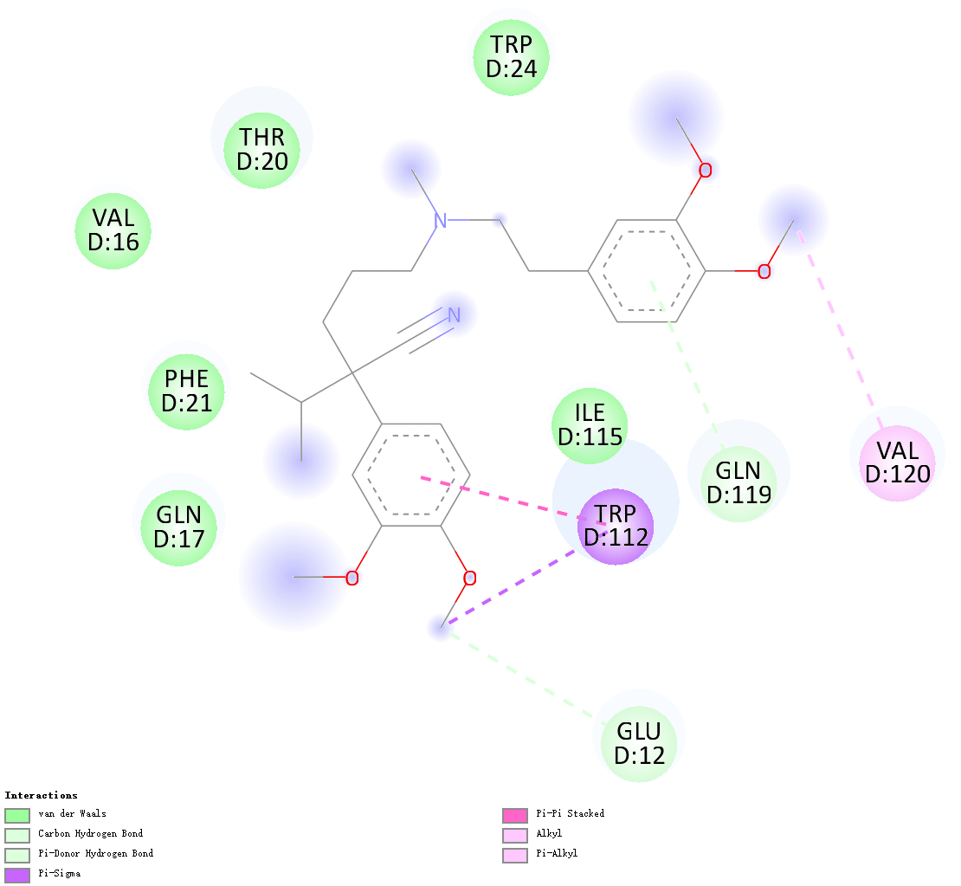
DMD-Verapamil

Slide 15
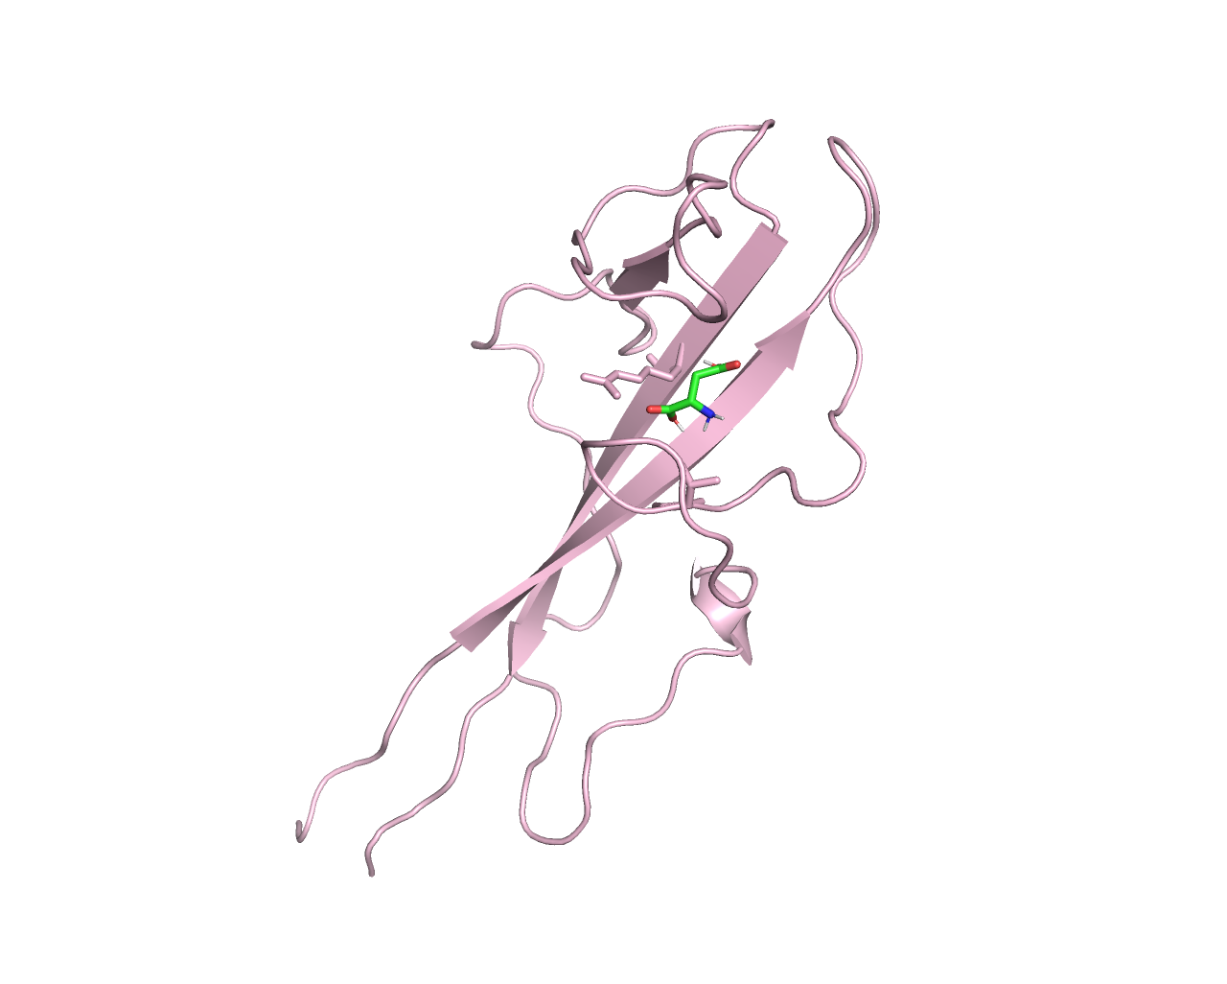
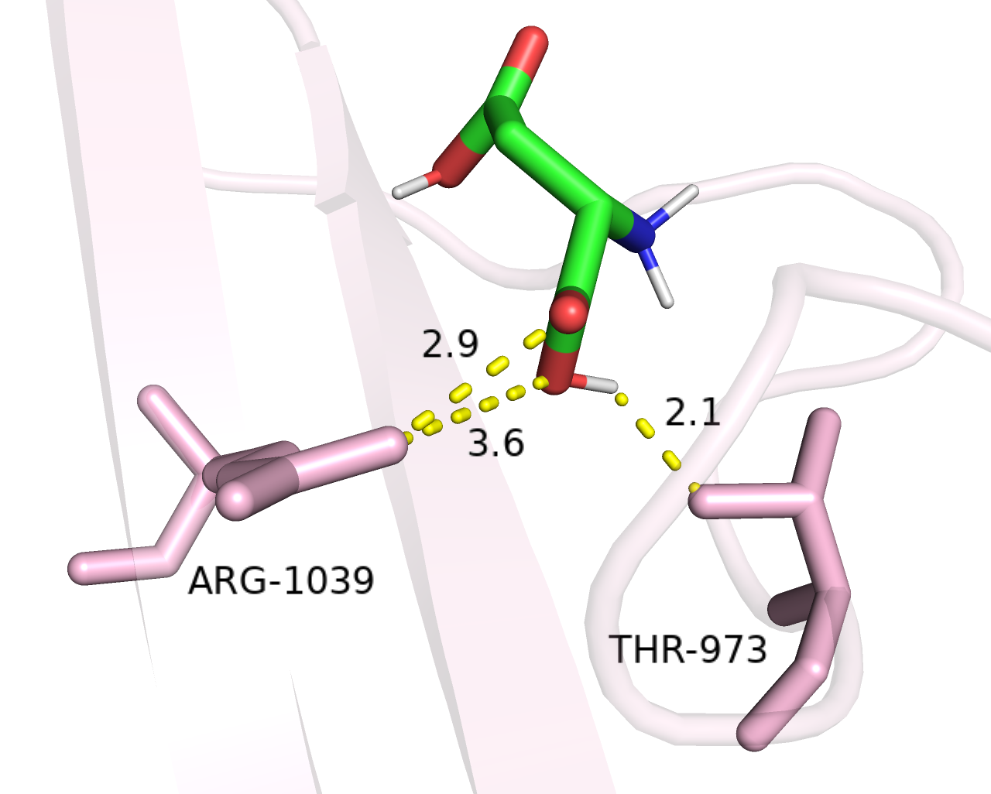
DYSF-Aspartic acid

Slide 16
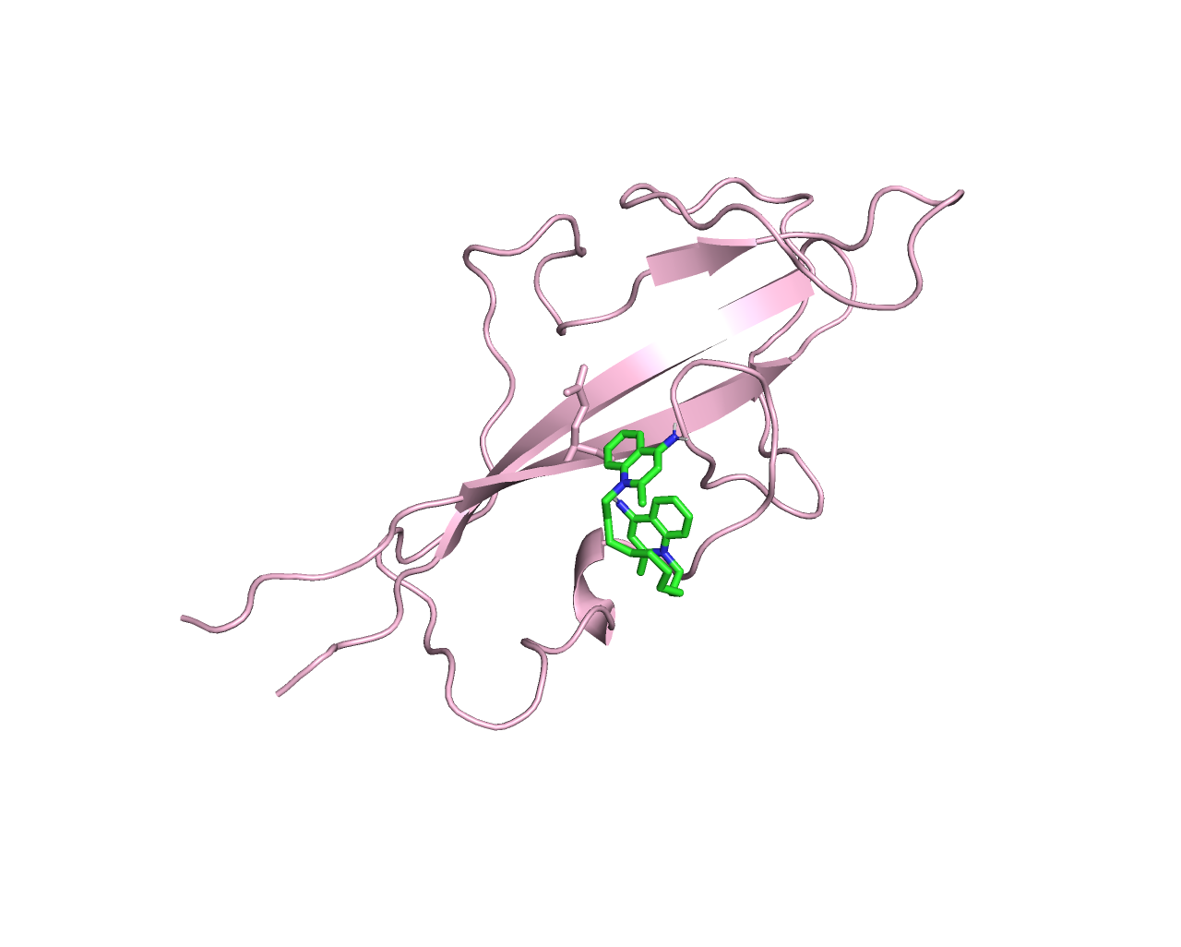
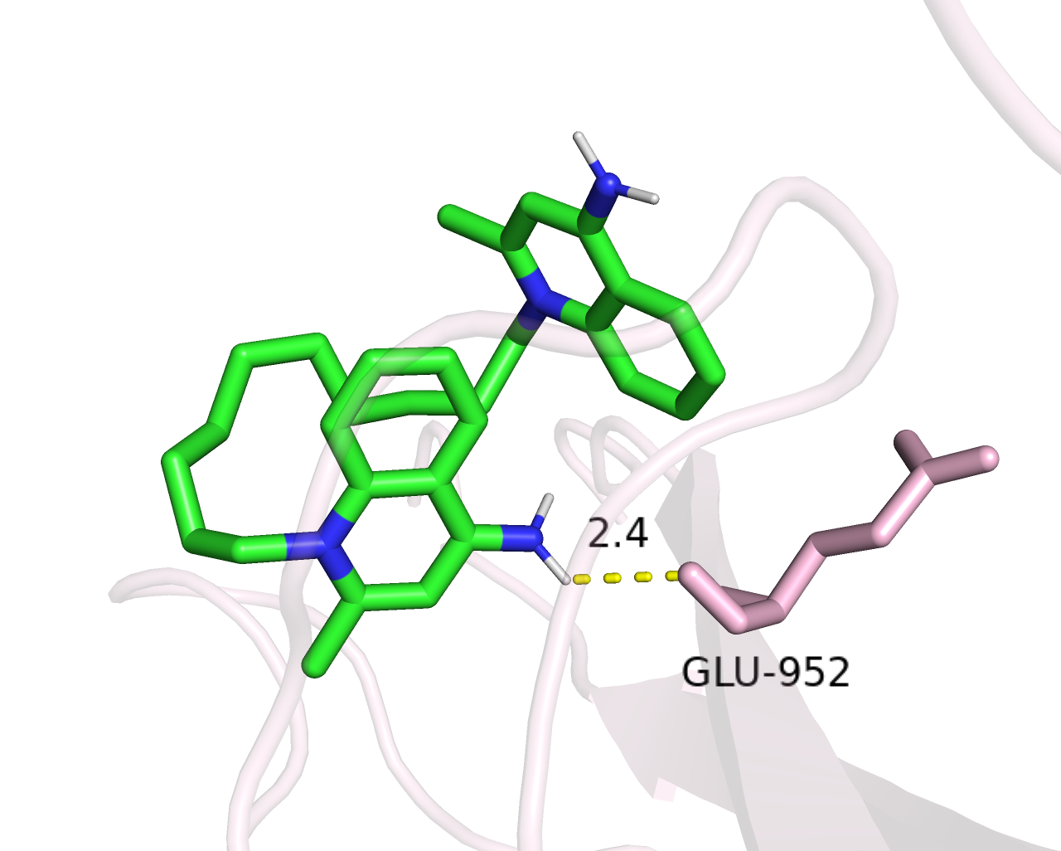
DYSF-Dequalinium

Slide 17
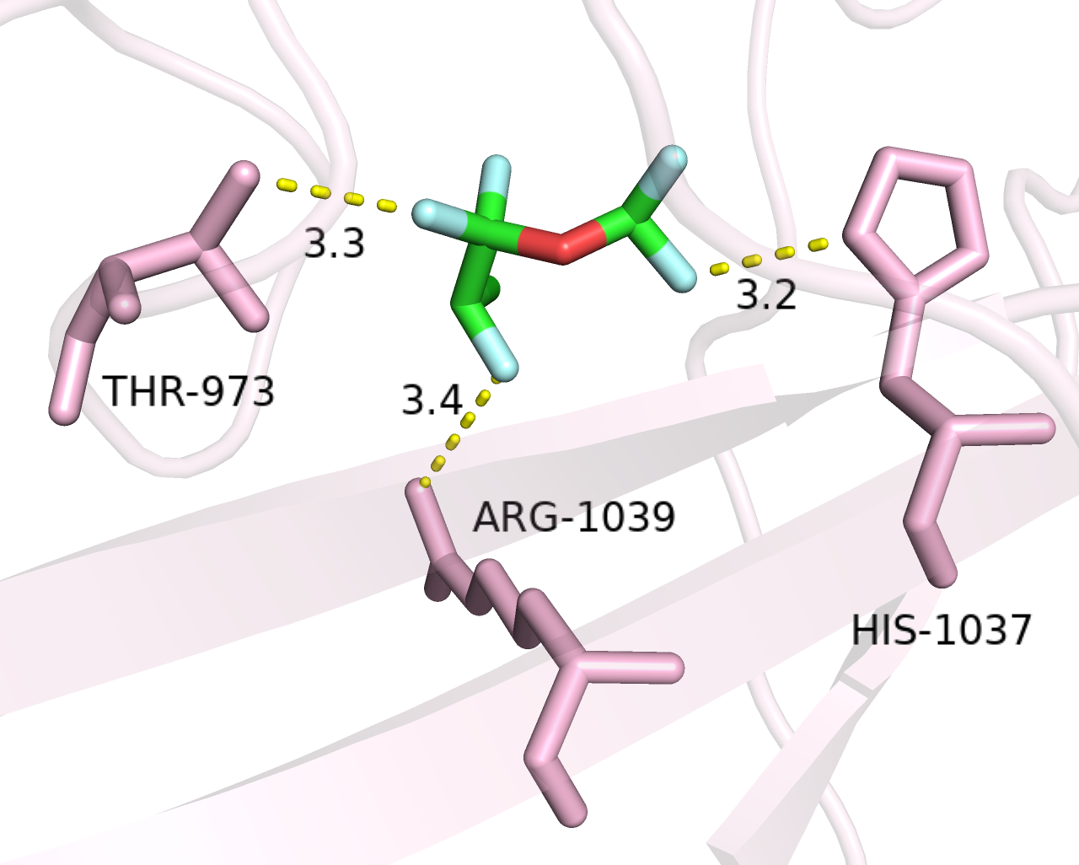
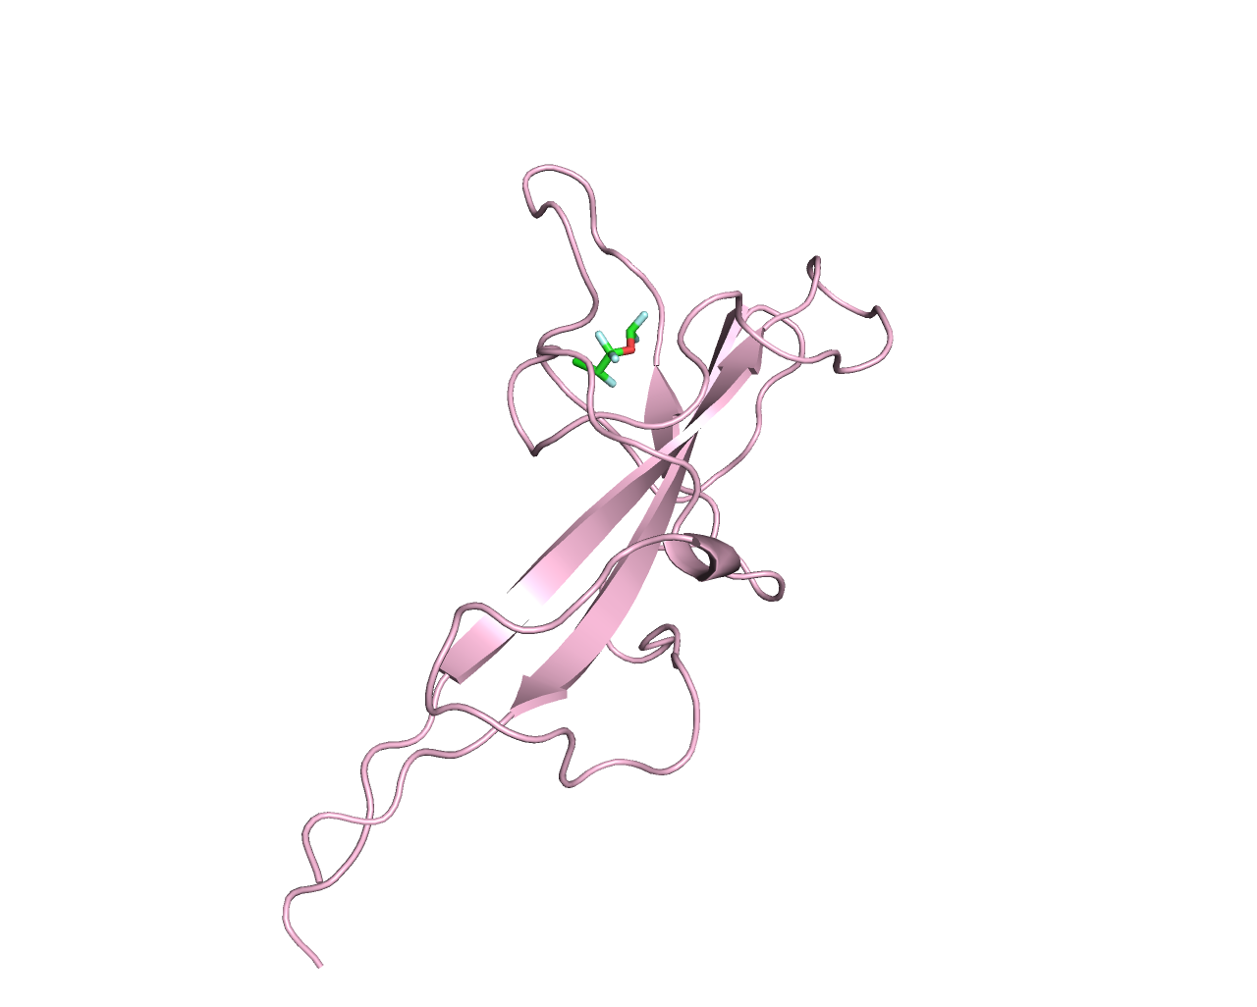
DYSF-Enflurane

Slide 18
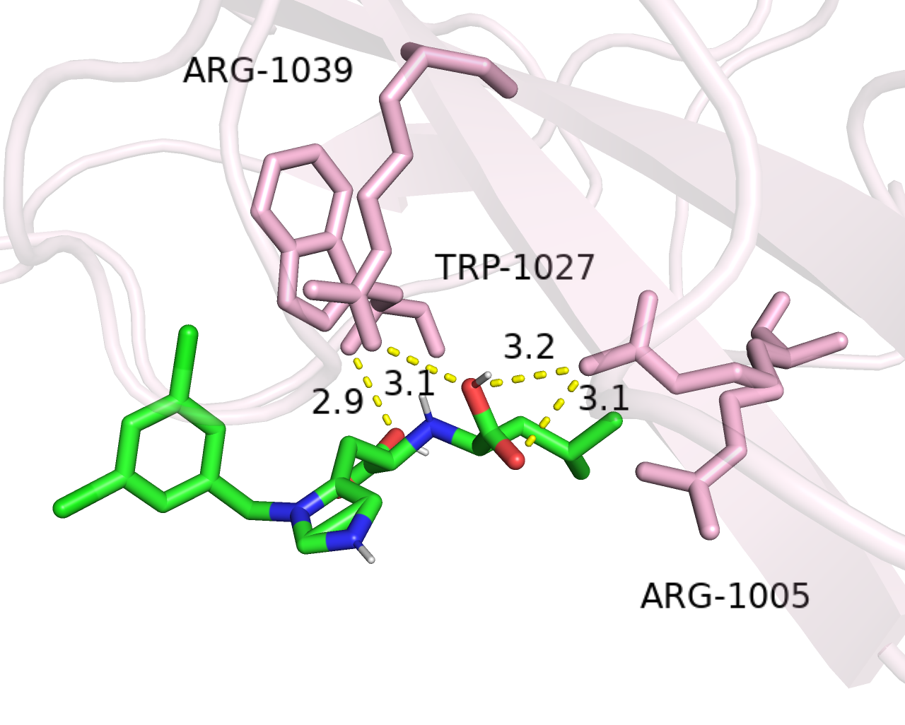
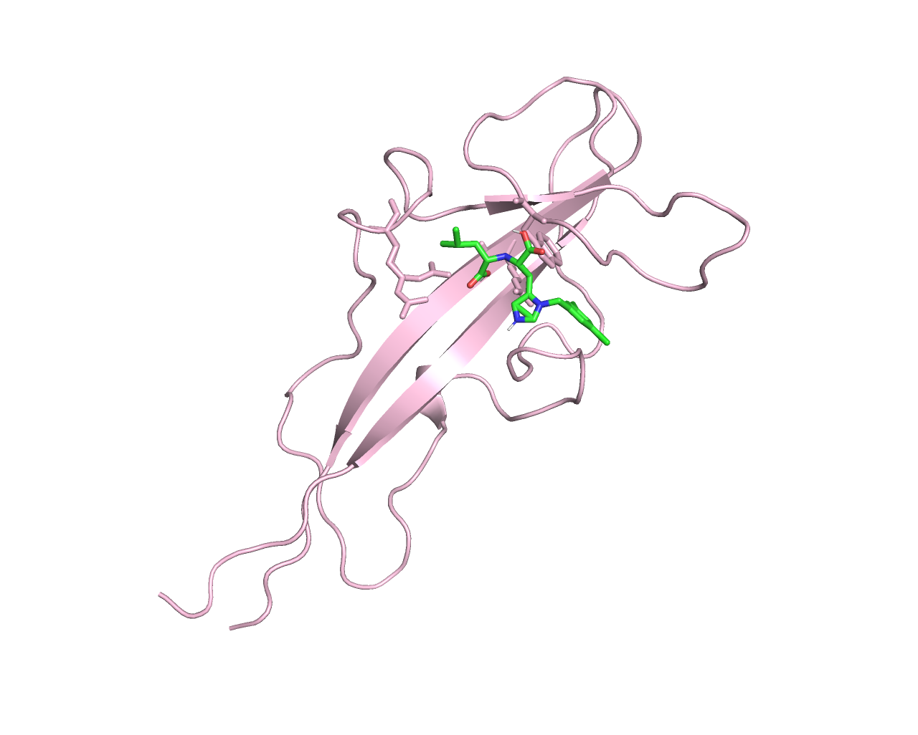
DYSF-ORE-1001

Slide 19
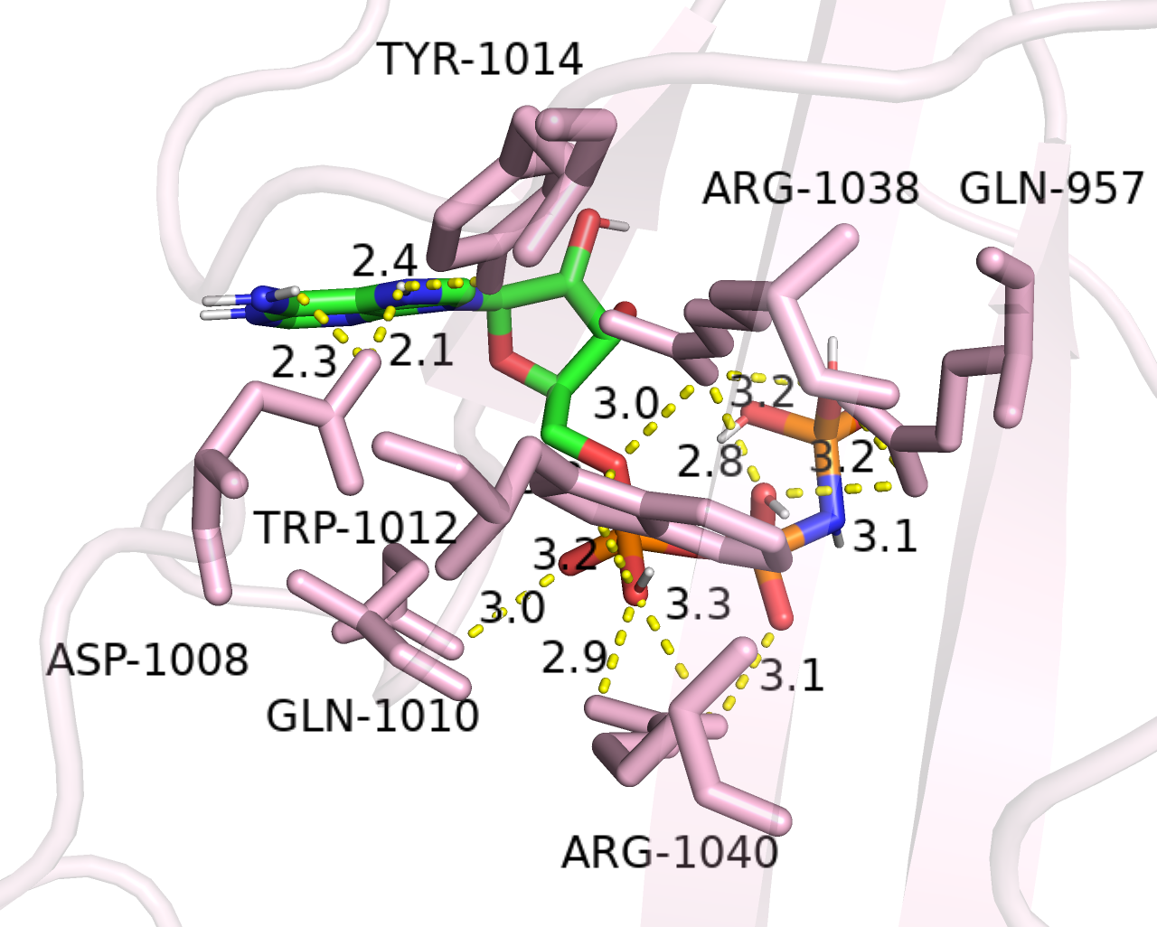
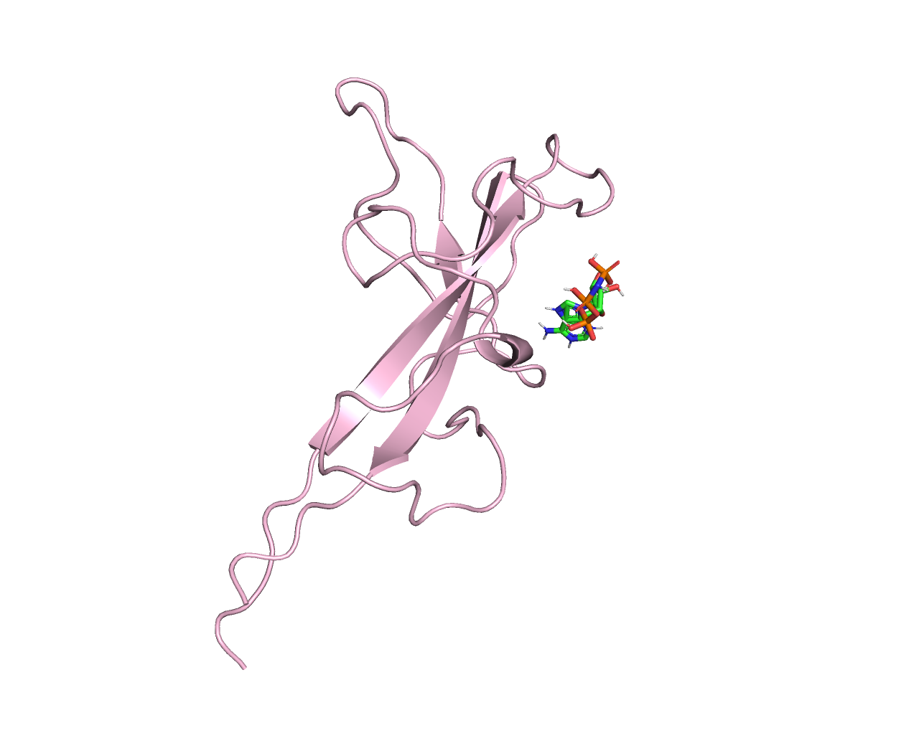
DYSF-Phosphoaminophosphonic Acid-Adenylate Ester

Slide 20
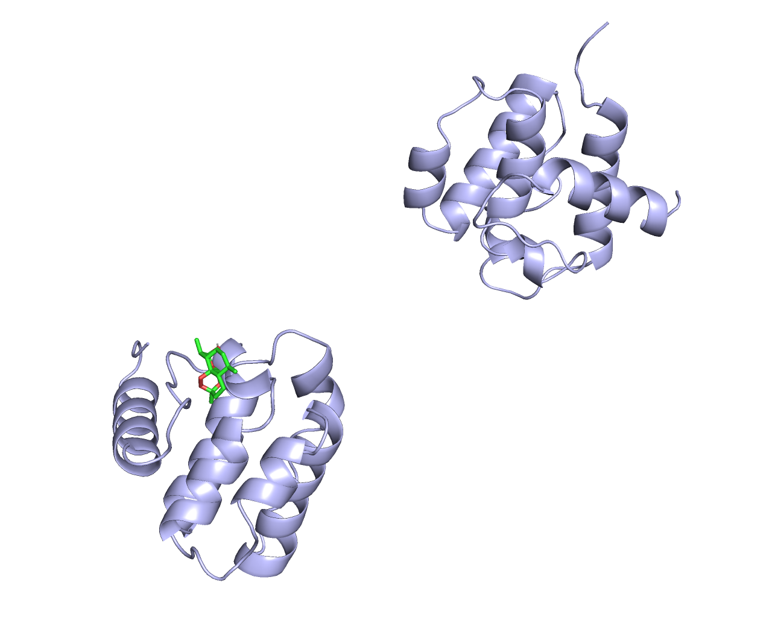
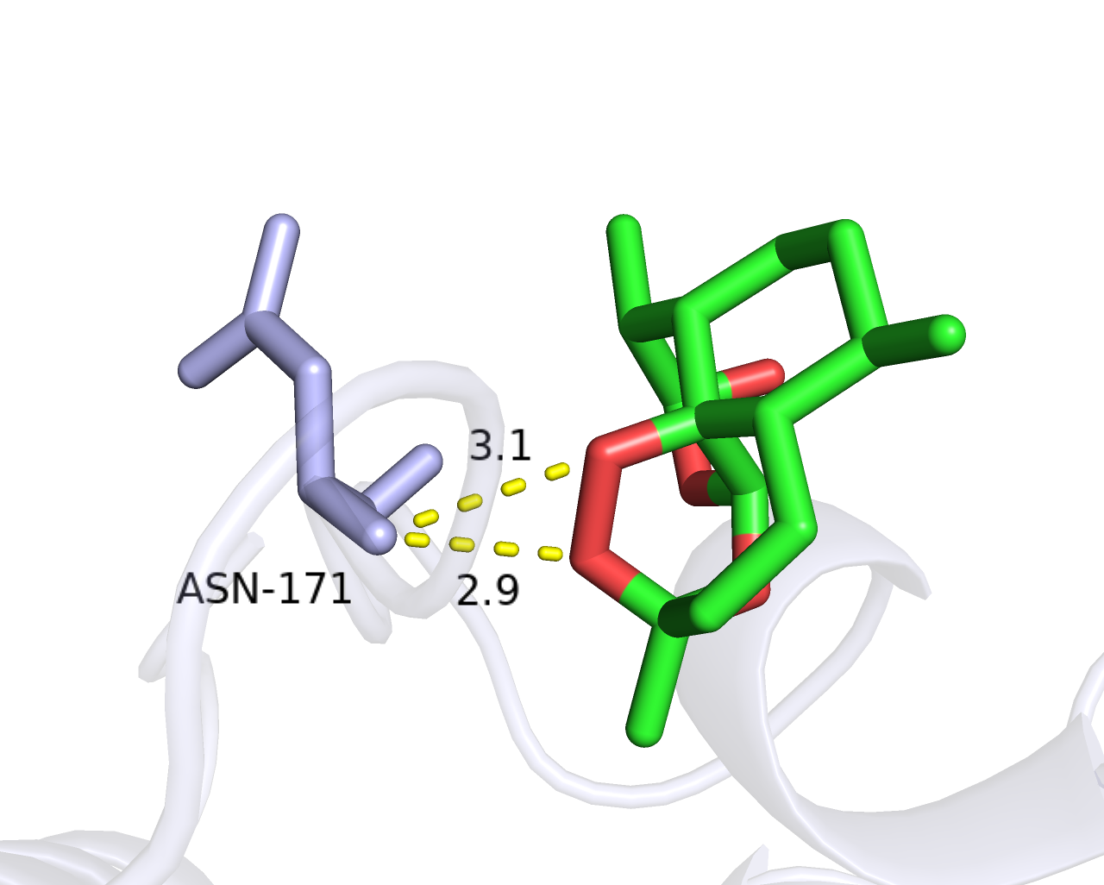
UTRN-Artenimol

Slide 21
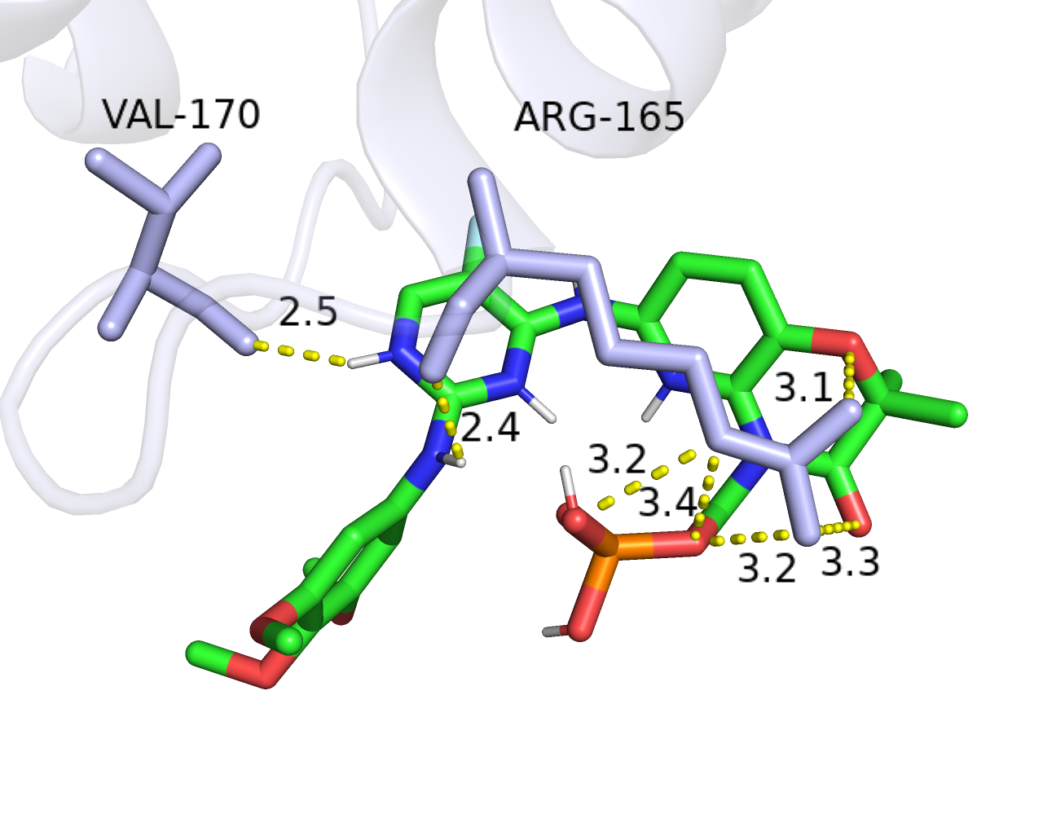
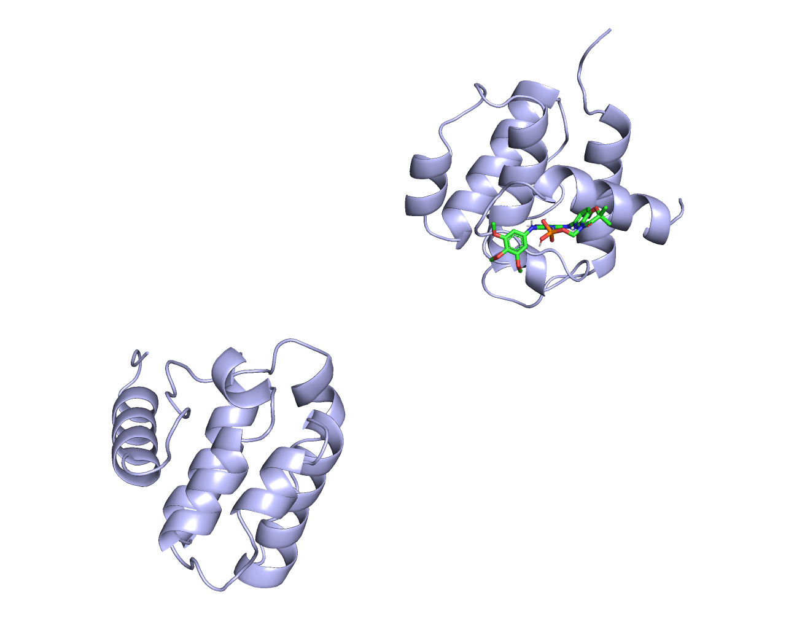
UTRN-Fostamatinib

Slide 22
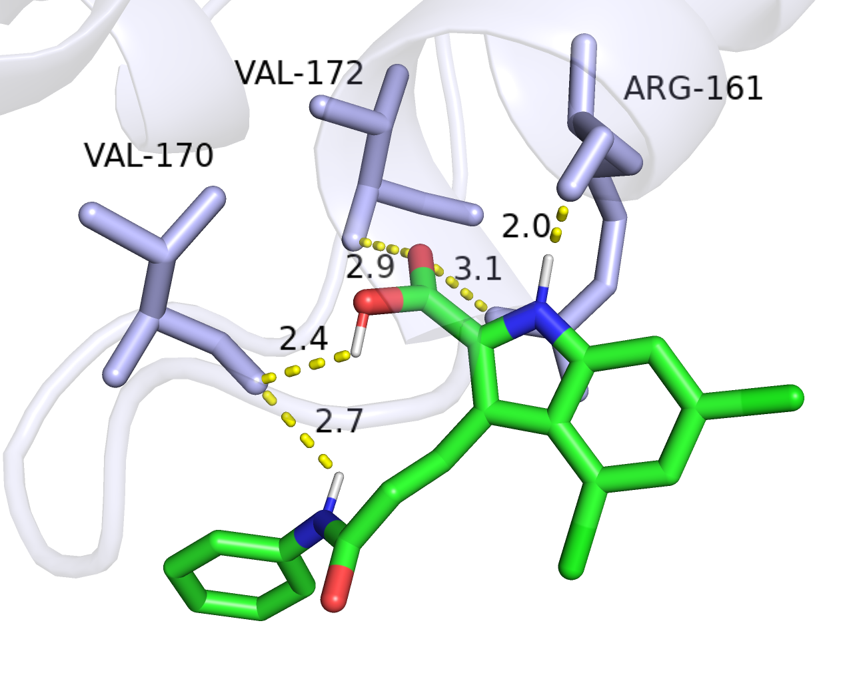
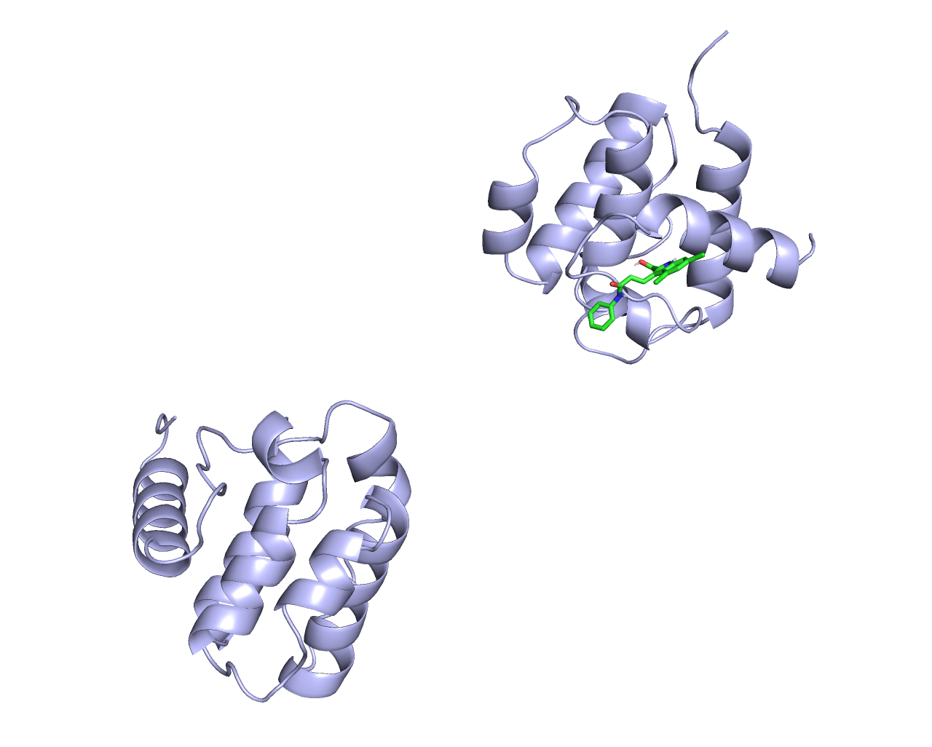
UTRN-Gavestinel

Slide 23
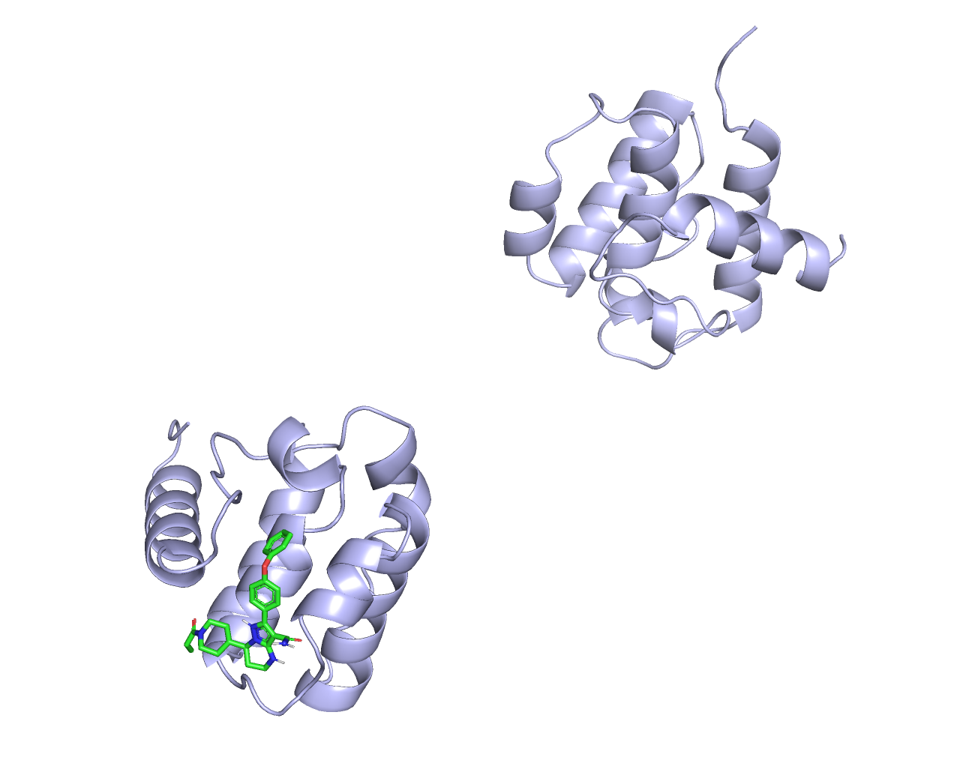
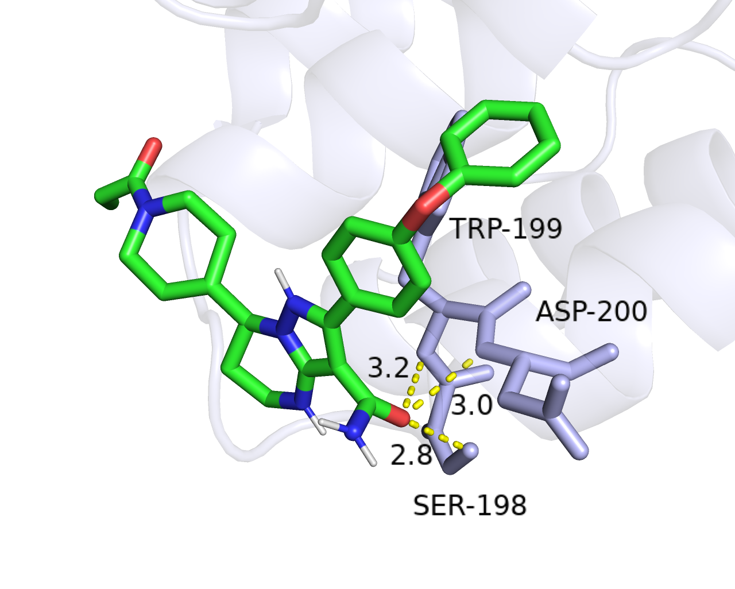
UTRN-Zanubrutinib

Slide 24
对接组合 | 结合能
DMD-4-Phenylbutyric Acid | -5.5
DMD-Artenimol | -6.3
DMD-Bosutinib | -7.7
DMD-Creatine | -4.2
DMD-Dequalinium | -7.1
DMD-Enflurane | -4.5
DMD-Fostamatinib | -6.7
DMD-Glutamic acid | -4.5
DMD-Phenethyl Isothiocyanate | -4.3
DMD-Pyridoxal phosphate | -5.3
DMD-Quinidine | -6.4
DMD-Seletracetam | -5.2
DMD-Vemurafenib | -7.9
DMD-Verapamil | -5.4
DYSF-Aspartic acid | -4.8
DYSF-Dequalinium | -5.2
DYSF-Enflurane | -4.5
DYSF-ORE-1001 | -5.9
DYSF-Phosphoaminophosphonic Acid-Adenylate Ester | -6.4
UTRN-Artenimol | -6.4
UTRN-Fostamatinib | -6.5
UTRN-Gavestinel | -7.8
UTRN-Zanubrutinib | -7.4

